Slide 1

Building community resilience to flooding
Tom Shopland
Natural Flood Management Advisor
Tom.Shopland@fwagsw.org.uk

Slide 2
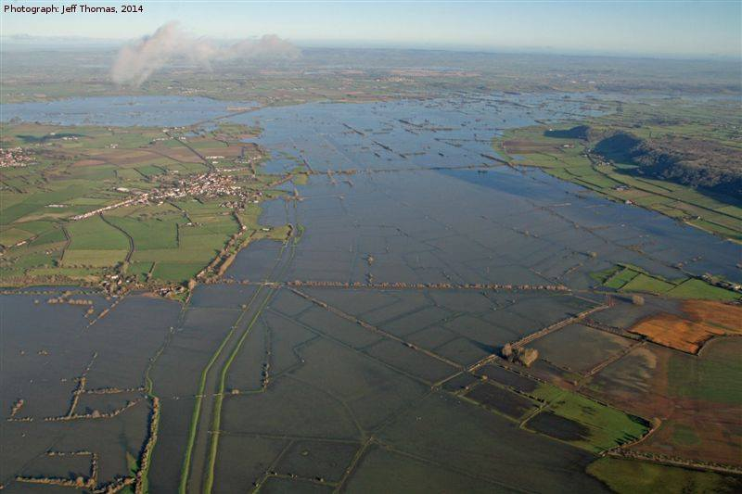
2014 Somerset 20 Year Flood Action Plan
Dredging and River Management – EA
Urban Run-off – District Councils
Resilient Highways Infrastructure – Highways Authority
Building Local Resilience – District Councils
Major Infrastructure Schemes – EA
Somerset Rivers Authority – County Council/IDB
Land Management – FWAGSW

Slide 3
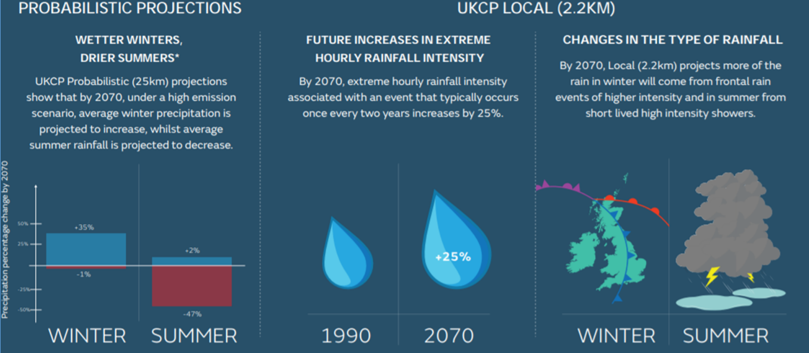

Slide 4
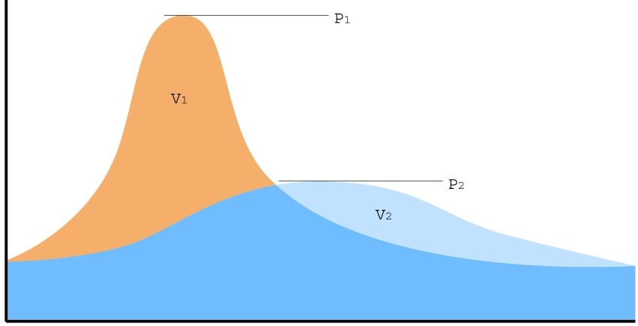
Natural Flood Management
“Every farm, every field and every stream has a part to play”
Flood peak without interventions
HEAVY RAIN
Reduced flood water volume through successful Natural Flood Management
Flood peak with NFM interventions
Volume
Time

Slide 5
In field
Reduce the occurrence of run-off and erosion within fields. Encourage rainwater infiltration into the soil by good soil management practices.
Edge of field
Intercept, slow, divert flow pathways before soil and water leave the field
In stream
Further slow the water and trap sediment in receiving ditches and streams. Reconnect streams with their flood plains the floodplain

Slide 6
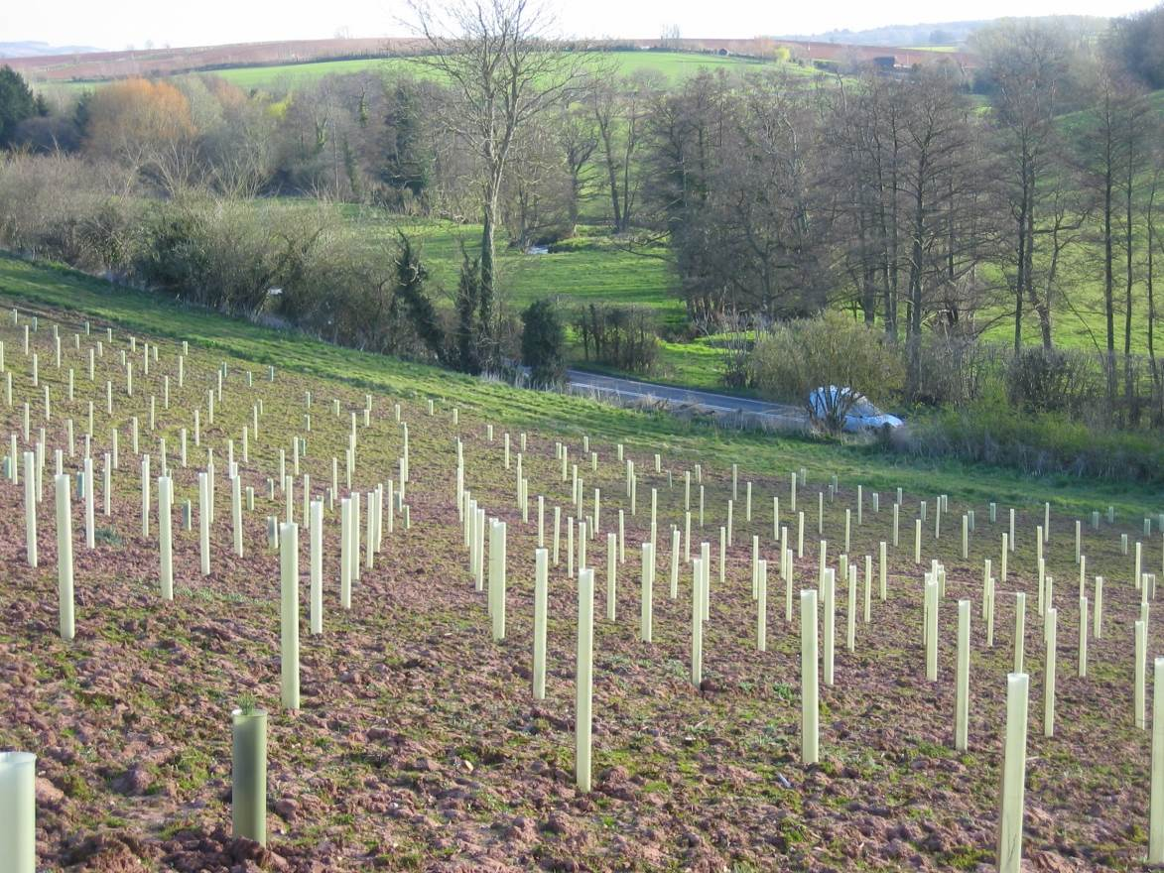
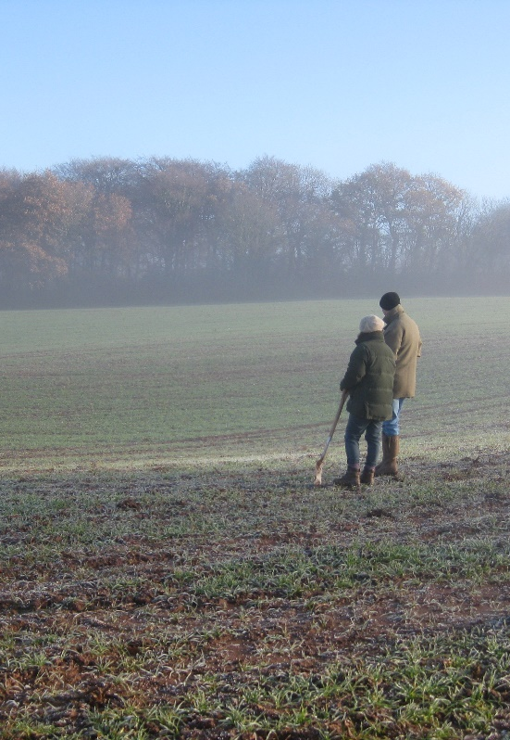
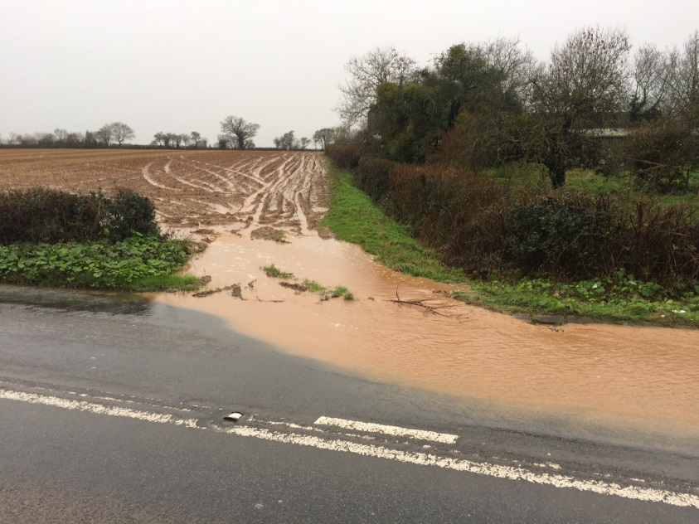
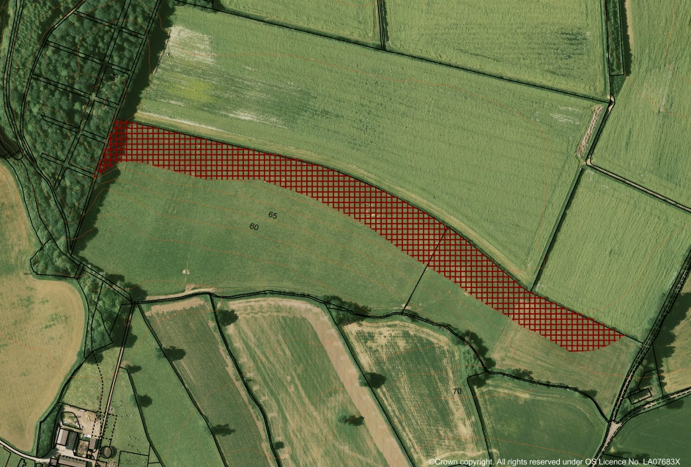
In field
Soils and land
management advice
Strategic tree planting
And hedges

Slide 7
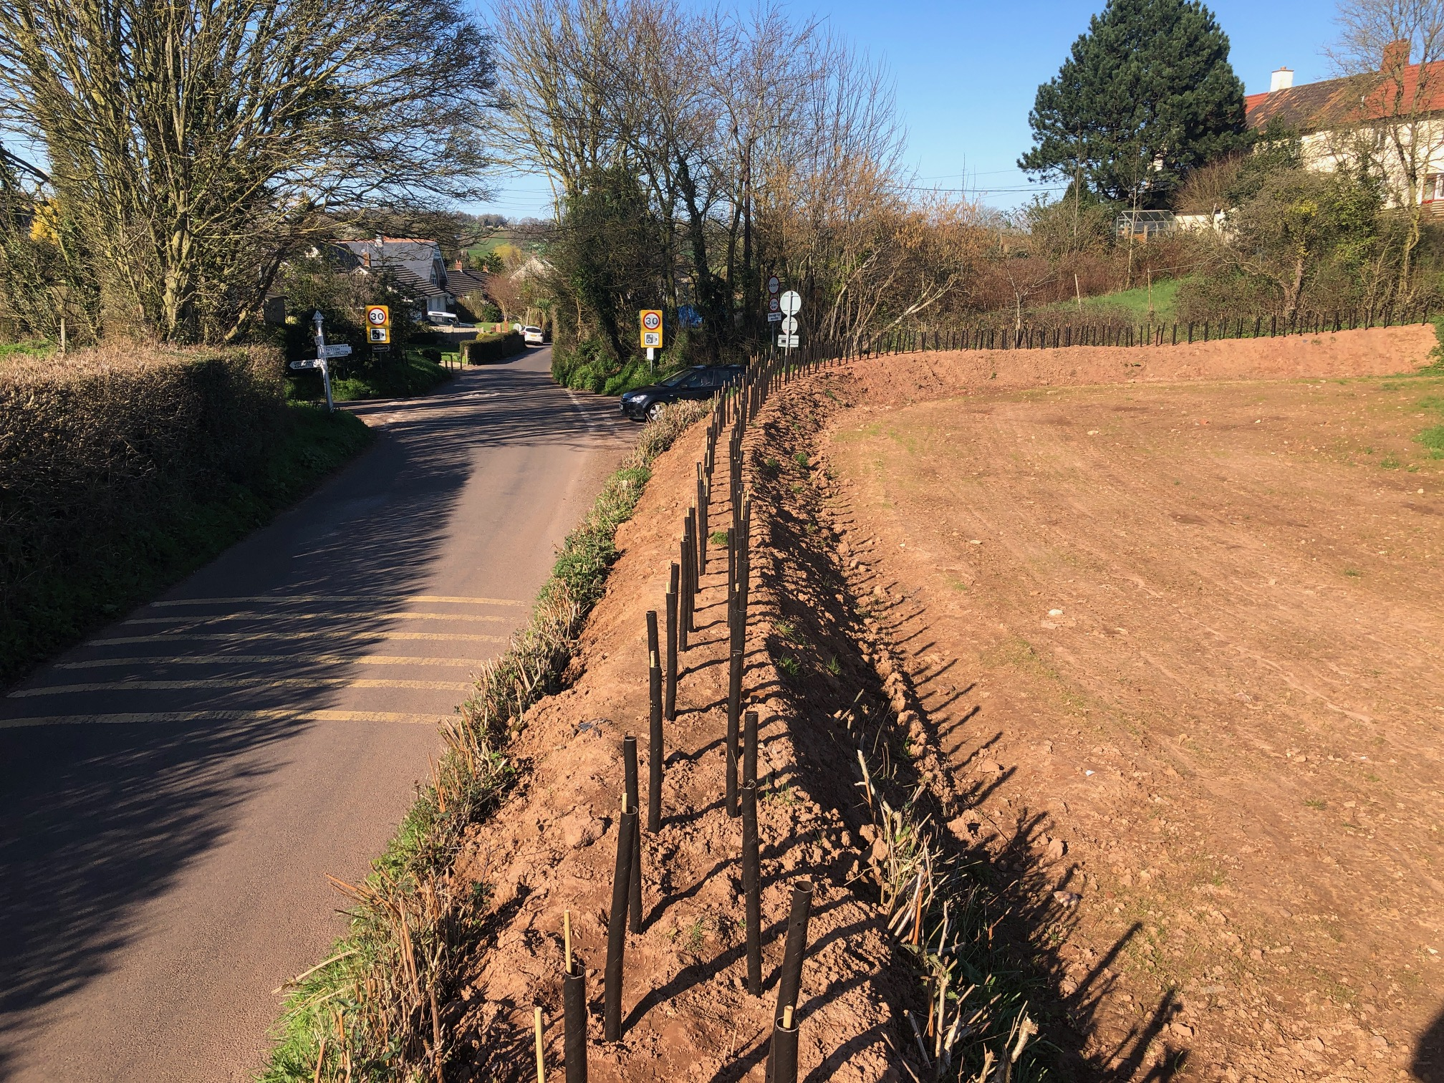
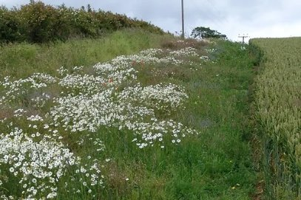
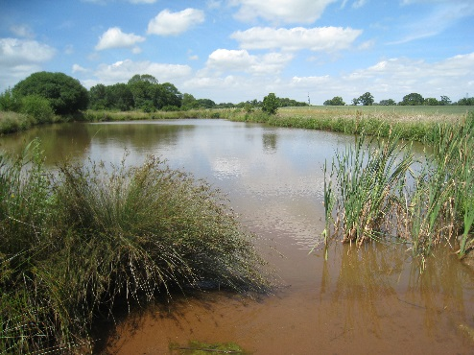
Edge of Field
Buffer strips
Bund & hedge
Ponds & wetlands

Slide 8
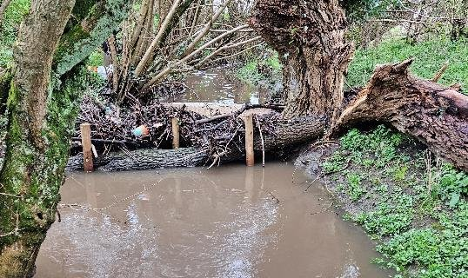
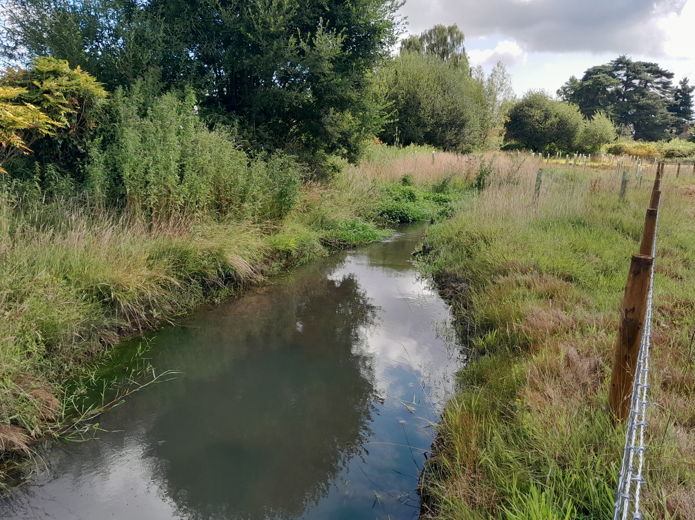
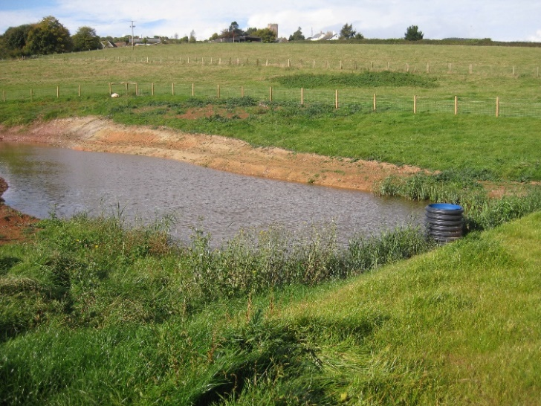
In Stream
Leaky dams
Renaturalising
watercourses
Online ponds

Slide 9
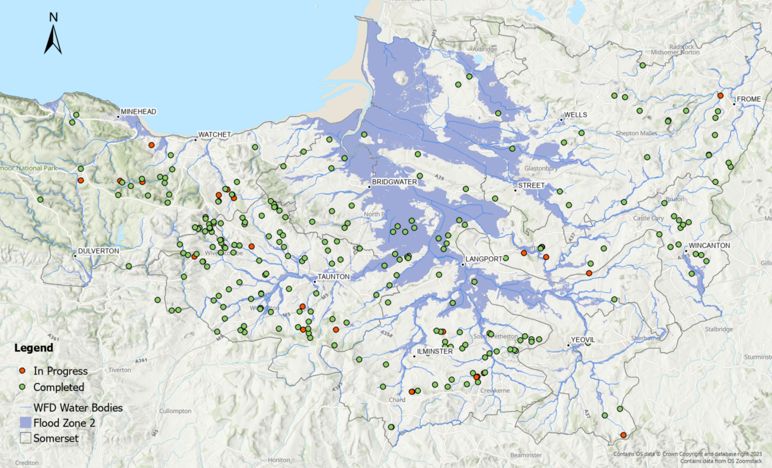
NFM Interventions 2015-2024

Slide 10
NFM Interventions 2015-2024
386 sites/farms – some with multiple interventions | Number of Interventions
In-stream (leaky dams, check dams, flow spreaders) | 333
In-field (filter fences, filter sox, coir rolls) | 121
Water storage (leaky ponds, scrapes, floodplain storage, bunds) | 146
Strategic planting (trees and hedges) | 71
Infrastructure (e.g. cross drains, fencing, yard improvements) | 85
TOTAL | 756
Land Management sites | 93
Soil husbandry | 3429ha

Slide 11
Where to start?
In field
1. Form a community action group
What geographic area will your project cover?
Who can help: parish council, residents, farmers, landowners, agencies, organisations
How are other communities building resilience?
2. Collecting local knowledge
Create a central space to gather information
Where are the flooding hotspots?
Walk/photograph the land on wet days
3. Identifying interventions
Where would an intervention most help?
Are there landowners and farmers who can help?
Get quotes from earthworks/drainage contractors

Slide 12
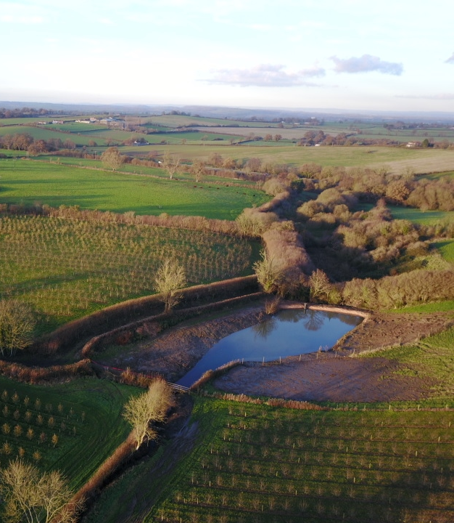

What are the next steps?
Who else should we speak with?
Where would an intervention have
the most impact?
Who can do what?

