Slide 1
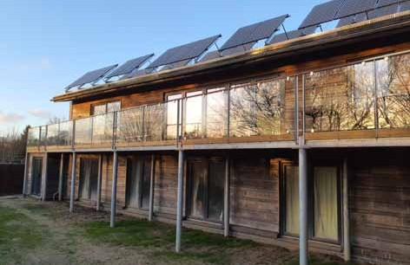
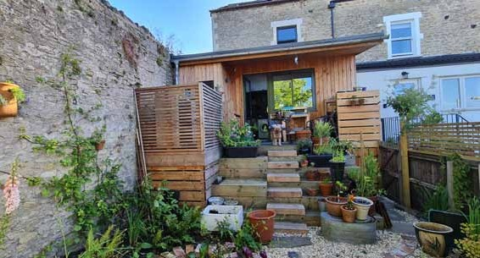
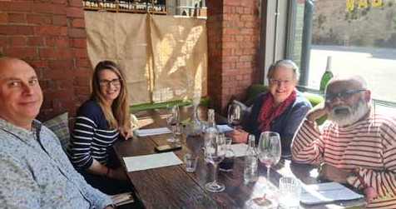
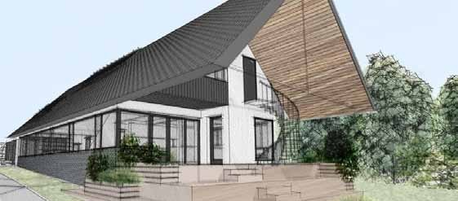

ECO ARCHITECTURE
“Put your money where your mouth is”
PAAD
Architects
Limited
T 01373 455500
E office@pa-ad.co.uk
W www.pa-ad.co.uk
Registered Office Address: 43 Poole Road, Westbourne, Bournemouth, BH4 9DN.
Registered in England & Wales.

Slide 2
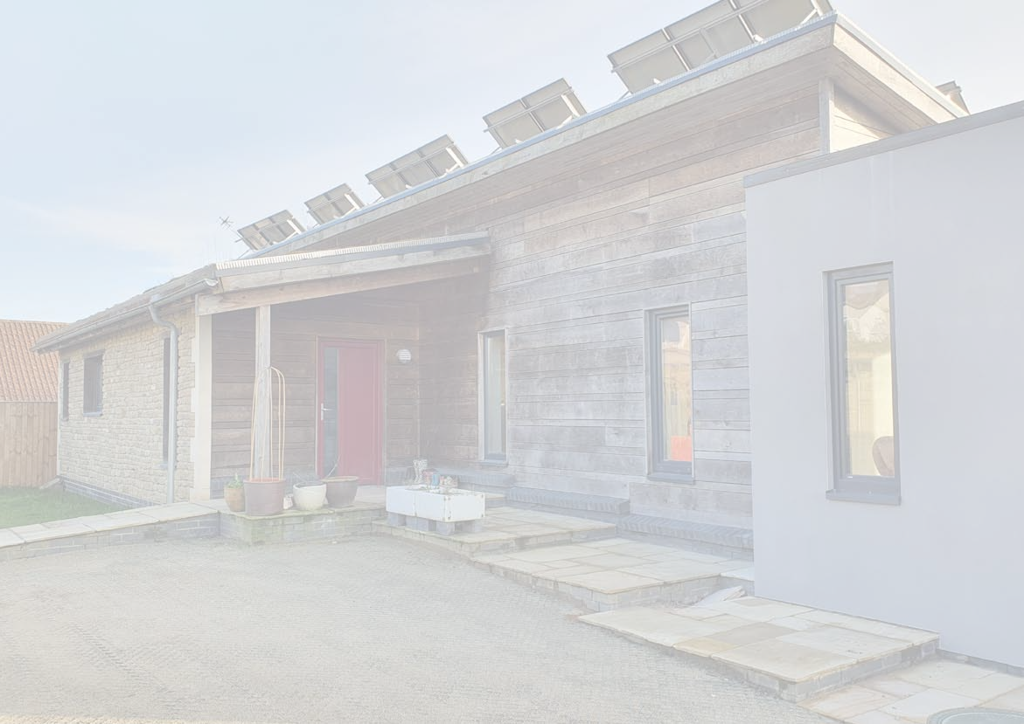
PAAD
Architects
Limited
ECO HOUSING- WHAT IS IT
My definition:
• Minimise harm to the planet.
• Endeavours to use less carbon in the sourcing the building materials for the home.
• Endeavours to use less carbon in the construction of the home.
• Endeavours to use less carbon in the operations of the home.
• Endeavours to use “natural” materials where possible.
• Use less fossil or no fossil fuels.
• Minimise waste during the construction.
• The result is a normal (?) home at the end of it.
T 01373 455500
E office@pa-ad.co.uk
W www.pa-ad.co.uk
Registered Office Address: 43 Poole Road, Westbourne, Bournemouth, BH4 9DN.
Registered in England & Wales.

Slide 3
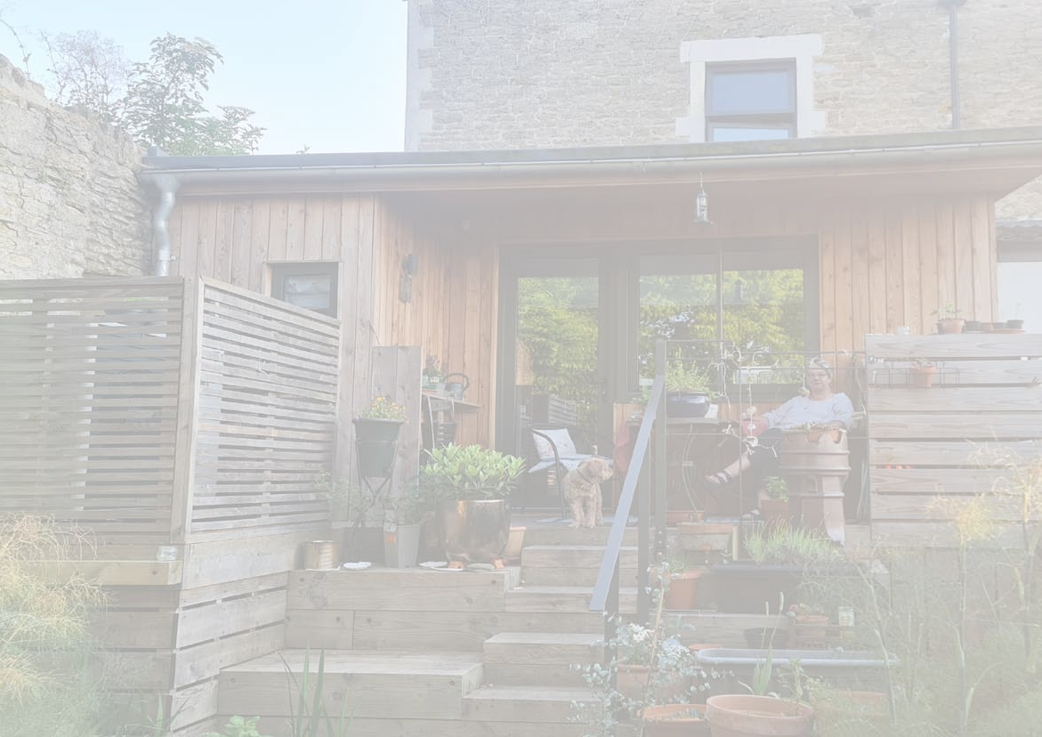
PAAD
Architects
Limited
ECO HOUSING- TYPES OF HOUSES.
NEW BUILD.- Nigel & Lucy’s home
REFURBISHMENT & EXTENSION-Terry & Paula’s home
RE-PURPOSING OTHER BUILDING TYPES. Louise & Gabe’s home
T 01373 455500
E office@pa-ad.co.uk
W www.pa-ad.co.uk
Registered Office Address: 43 Poole Road, Westbourne, Bournemouth, BH4 9DN.
Registered in England & Wales.

Slide 4
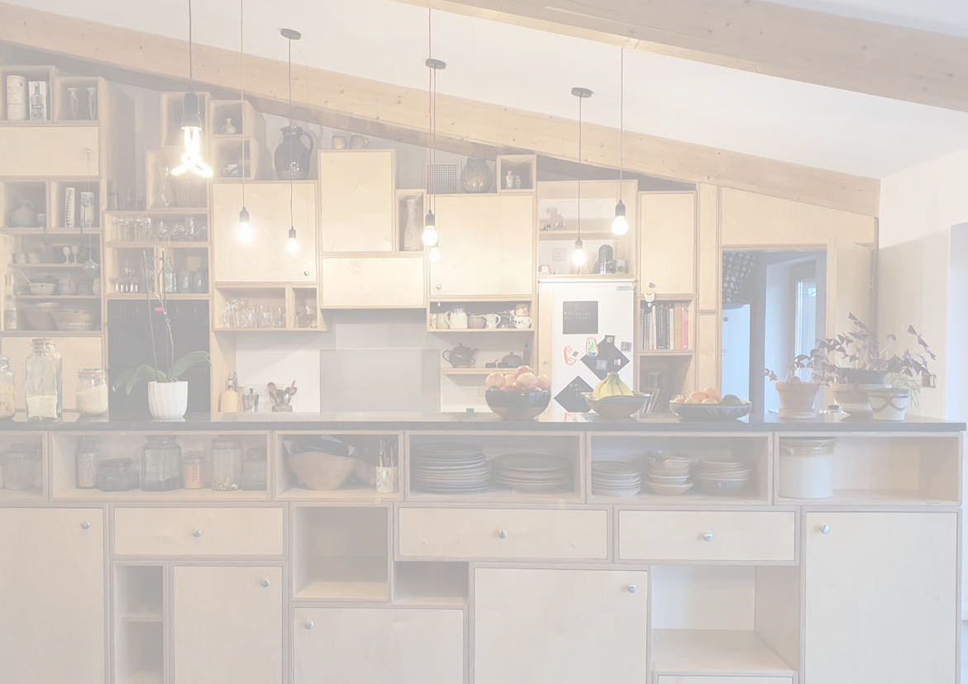
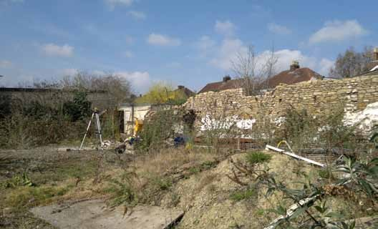
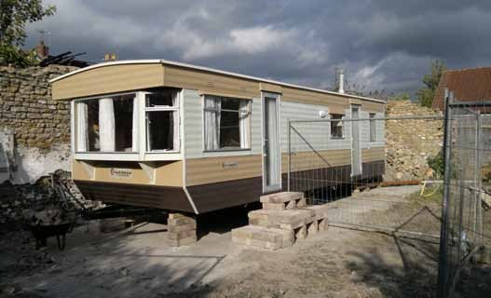
Architects Nigel & Lucy’s Home-Old Lemonade Factory,
PAAD
^{Limited} Zero Carbon New Build
• Bought the plot at auction in 2011.
• Achieved planning permission for a zero carbon family home.
• Code for Sustainable Homes Level 6
• Self build and projected managed it himself.
• Construction Cost £2,000m². Todays Rates £4,000m²
T 01373 455500
E office@pa-ad.co.uk
W www.pa-ad.co.uk
Registered Office Address: 43 Poole Road, Westbourne, Bournemouth, BH4 9DN.
Registered in England & Wales.

Slide 5

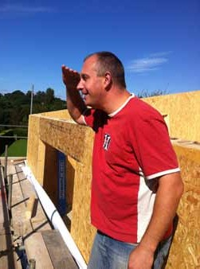
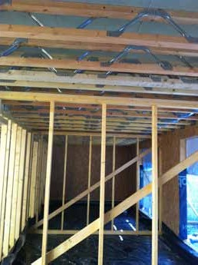
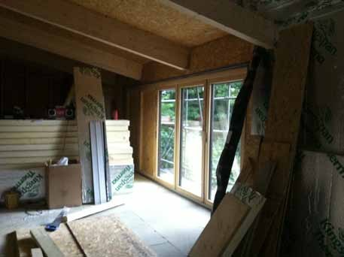
PAAD
Architects
Limited
CONSTRUCTION
• SIP ( structurally Integrated panels)- high insulation levels.
• Timber Frame Roof
• Ground floor- Concrete beams with insulated blocks & screed.
• First Floor- Posijoists
• Windows-Triple glazed composite ( wood inside & aluminium outside).
T 01373 455500
E office@pa-ad.co.uk
W www.pa-ad.co.uk
Registered Office Address: 43 Poole Road, Westbourne, Bournemouth, BH4 9DN.
Registered in England & Wales.

Slide 6
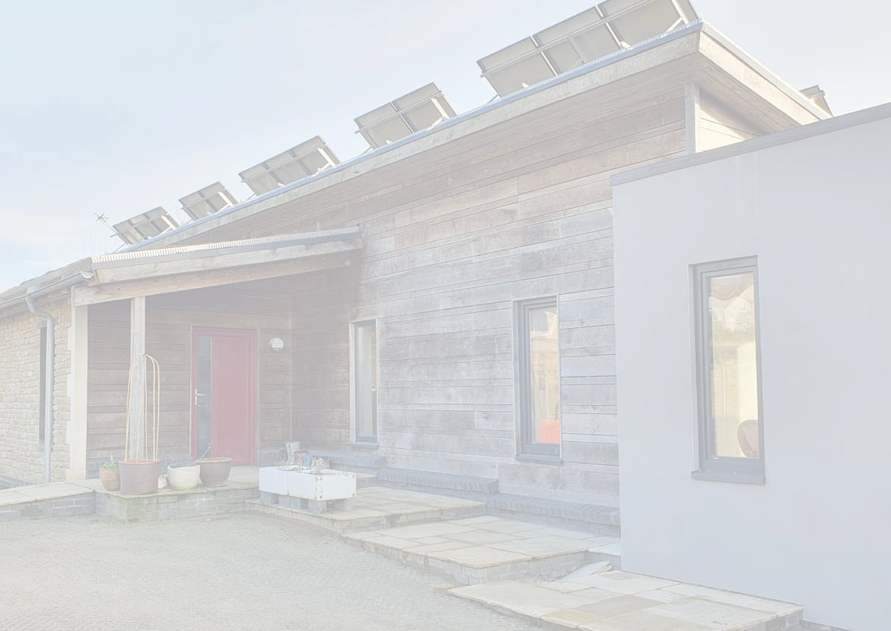
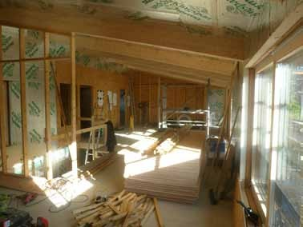
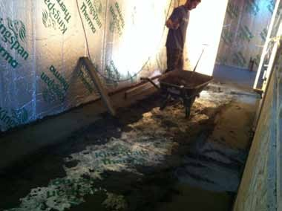
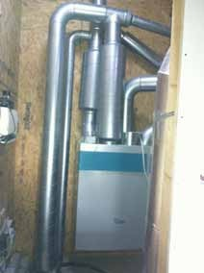
PAAD
Architects
Limited
ENERGY
• Minimise heating with high insulation values,
• Minimise heat loss with high air tightness.
• Minimise heat loss for ventilation with MVHR ( mechanical ventilation heat recovery).
• Offset fossil fuel usage with 9.75 KW Photo voltaic solar panels.
• Supplement hot water with gas boiler.
T 01373 455500
E office@pa-ad.co.uk
W www.pa-ad.co.uk
Registered Office Address: 43 Poole Road, Westbourne, Bournemouth, BH4 9DN.
Registered in England & Wales.

Slide 7
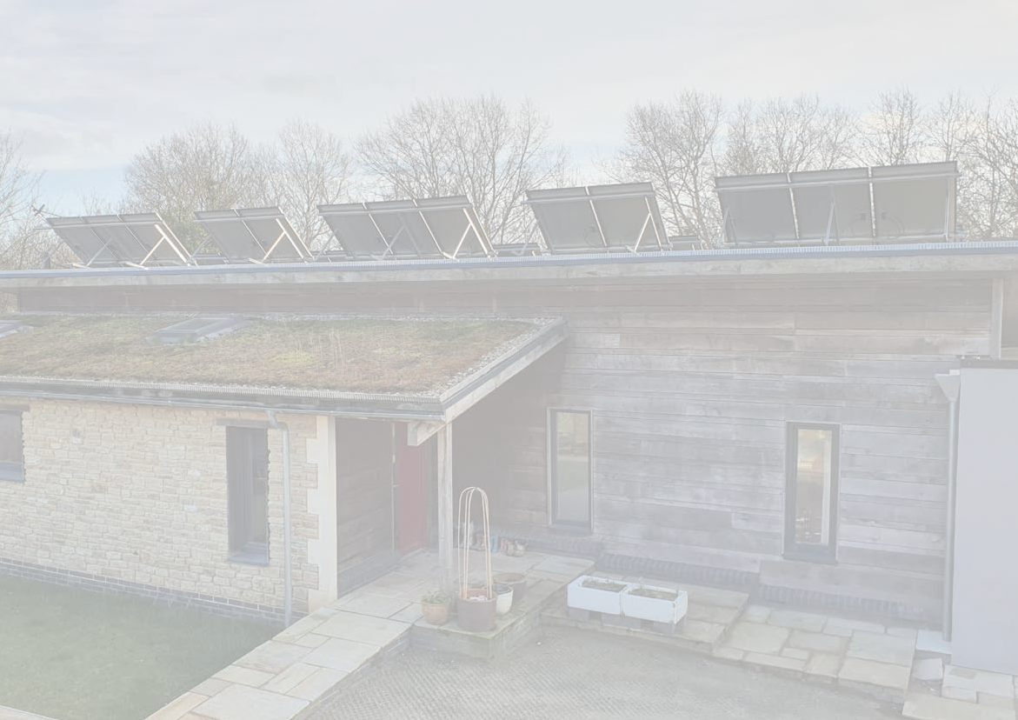
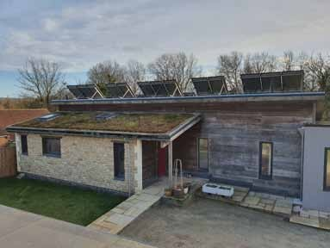
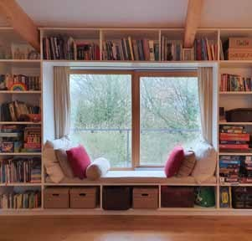
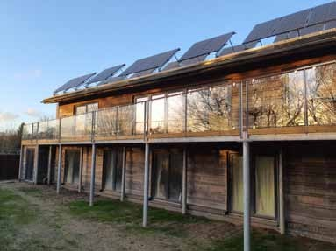
PAAD
Architects
Limited
OTHER SUSTAINABILITY MEASURES
• Grey water recycling.
• Sedum roof to enhance biodiversity to attenuate storm water dis- charge.
• Oak cladding.
• Reuse existing retaining wall.
T 01373 455500
E office@pa-ad.co.uk
W www.pa-ad.co.uk
Registered Office Address: 43 Poole Road, Westbourne, Bournemouth, BH4 9DN.
Registered in England & Wales.

Slide 8
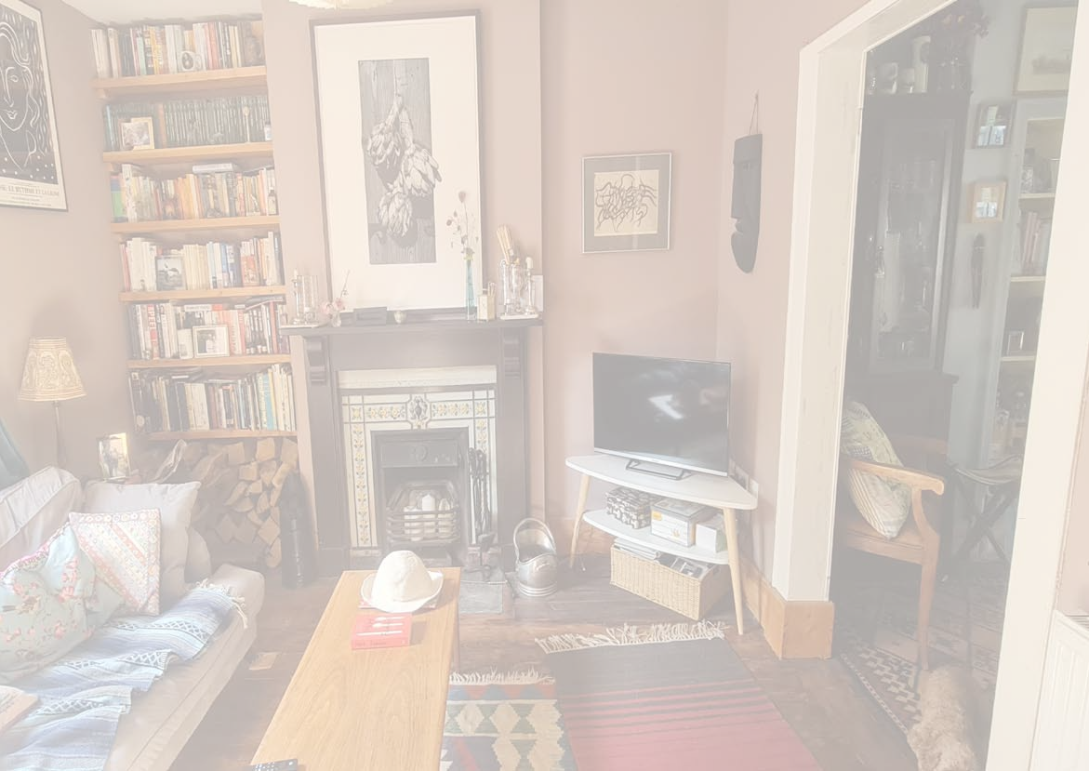
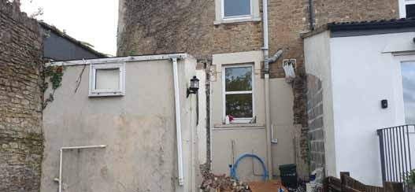
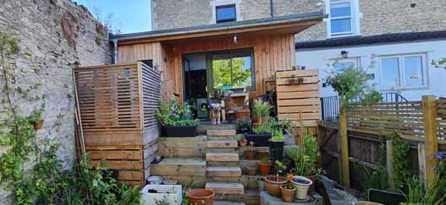
Architects Terry & Paula’s Home. 26C Milk Street, Frome.
PAAD
^{Limited} Eco-Refurb of a Victorian End of Terrace House
• Utilised an inheritance to modernise, remodel and extend our conservation area home.
• Political/moral choice to come of gas, so not using fossil fuels.
• “Common Sense” eco refurbishment.
• Designed to meet our needs now and also for later in life.
• Not perfect, compromises and mistakes made!
• Lock in carbon by refurbishing existing house instead of new build.
• Construction Costs. £1,200m²
T 01373 455500
E office@pa-ad.co.uk
W www.pa-ad.co.uk
Registered Office Address: 43 Poole Road, Westbourne, Bournemouth, BH4 9DN.
Registered in England & Wales.

Slide 9
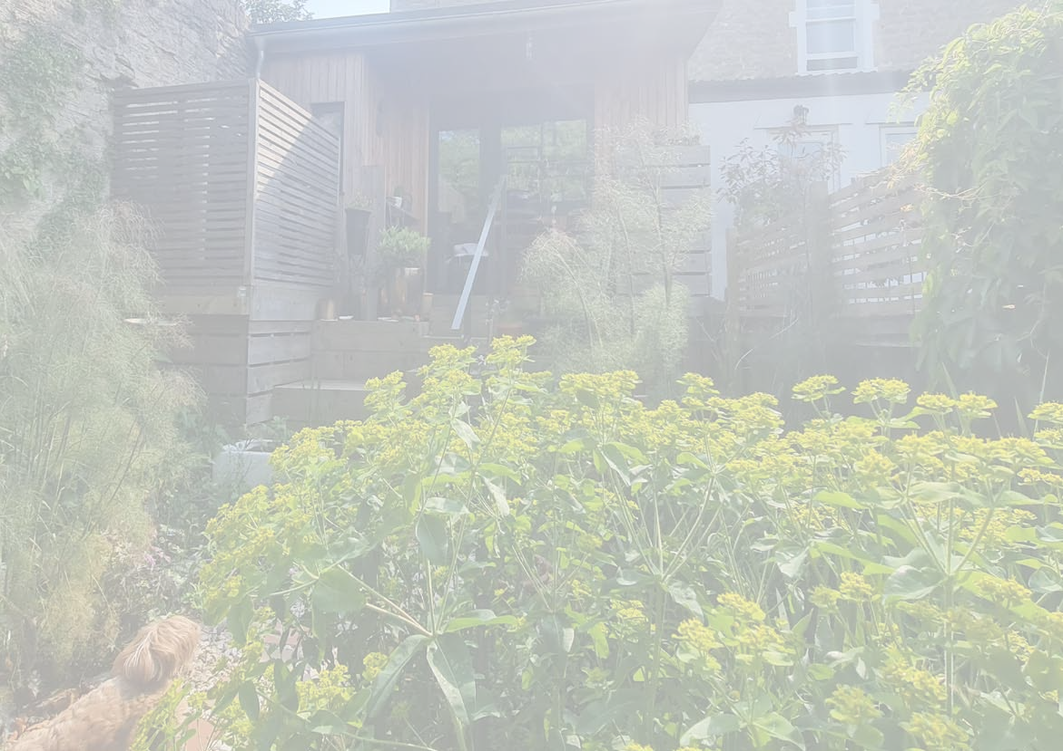
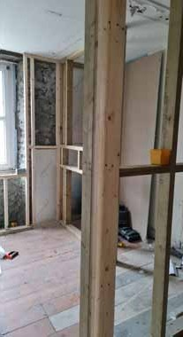
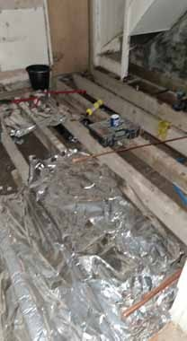
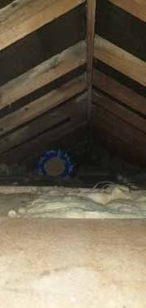
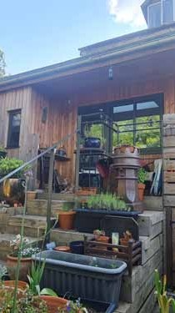
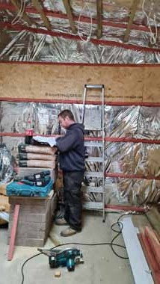
PAAD
^{Architects} CONSTRUCTION
Limited
• Independent internal framed insulation to walls.
• Insulate existing floor.
• Re-insulate existing roof.
• Replacement and new glazing- Triple glazed aluminium.
• Extension- Highly insulated timber frame.
T 01373 455500
E office@pa-ad.co.uk
W www.pa-ad.co.uk
Registered Office Address: 43 Poole Road, Westbourne, Bournemouth, BH4 9DN.
Registered in England & Wales.

Slide 10
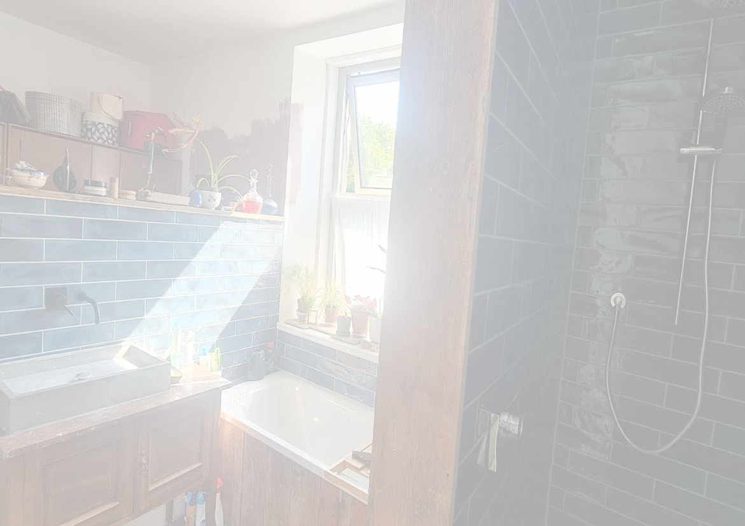
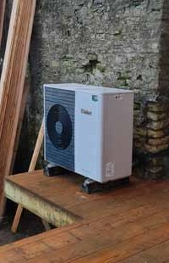
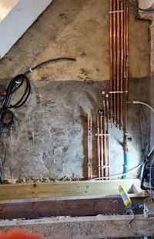
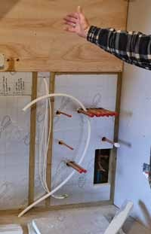
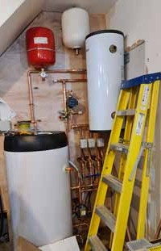
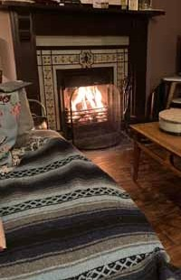
PAAD
Architects
Limited
ENERGY
• Come of gas totally and replace heating and hot water provision with a Vaillant EcoTherm ASHP ( Air Source Heat Pump).
• Took us 1 1/2 years to get the system balanced properly.
• Not cheaper than a gas boiler as runs on electricity to run the pumps.
• Replace cooker with induction hob.
• Retain open fire.
• New smaller radiators
T 01373 455500
E office@pa-ad.co.uk
W www.pa-ad.co.uk
Registered Office Address: 43 Poole Road, Westbourne, Bournemouth, BH4 9DN.
Registered in England & Wales.

Slide 11
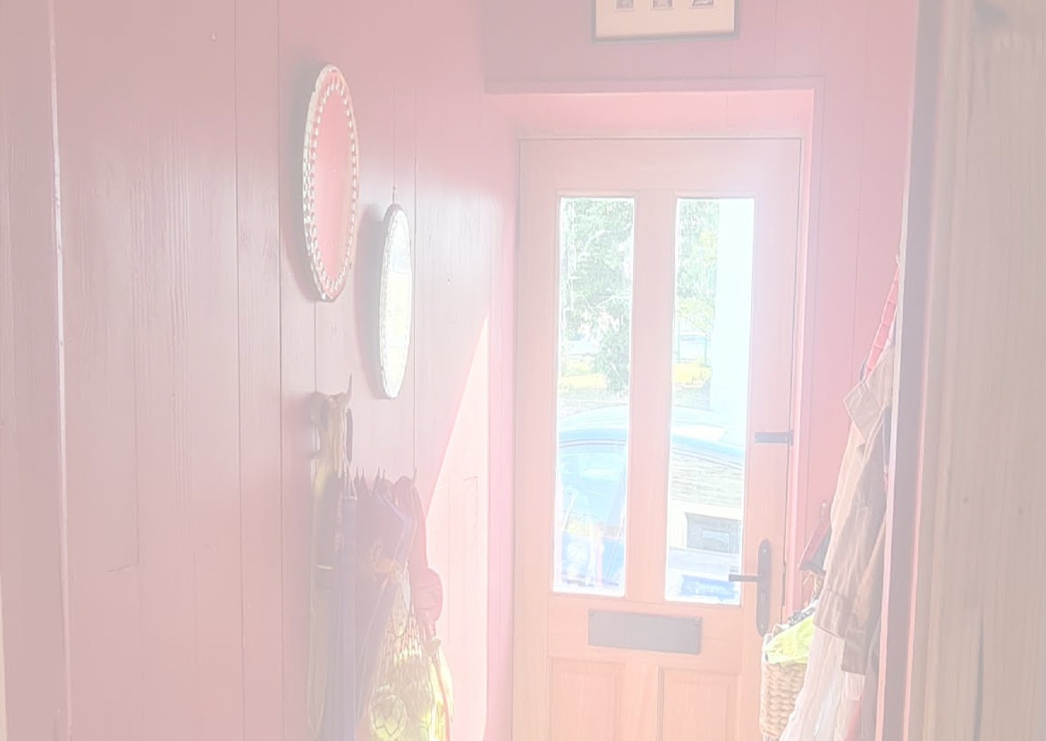
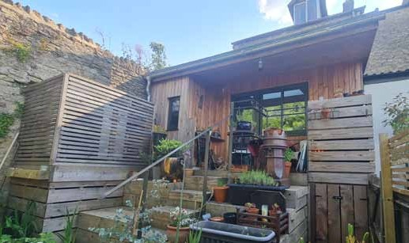
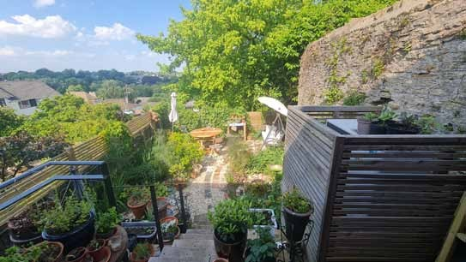
PAAD
Architects
Limited
OTHER SUSTAINABILITY MEASURES
• Sedum Roof( to be fitted).
• Larch cladding and extensive use of timber.
• Reuse of materials.
• Minimal new build.
• Wildlife friendly garden ( David Oakley Gardening).
T 01373 455500
E office@pa-ad.co.uk
W www.pa-ad.co.uk
Registered Office Address: 43 Poole Road, Westbourne, Bournemouth, BH4 9DN.
Registered in England & Wales.

Slide 12
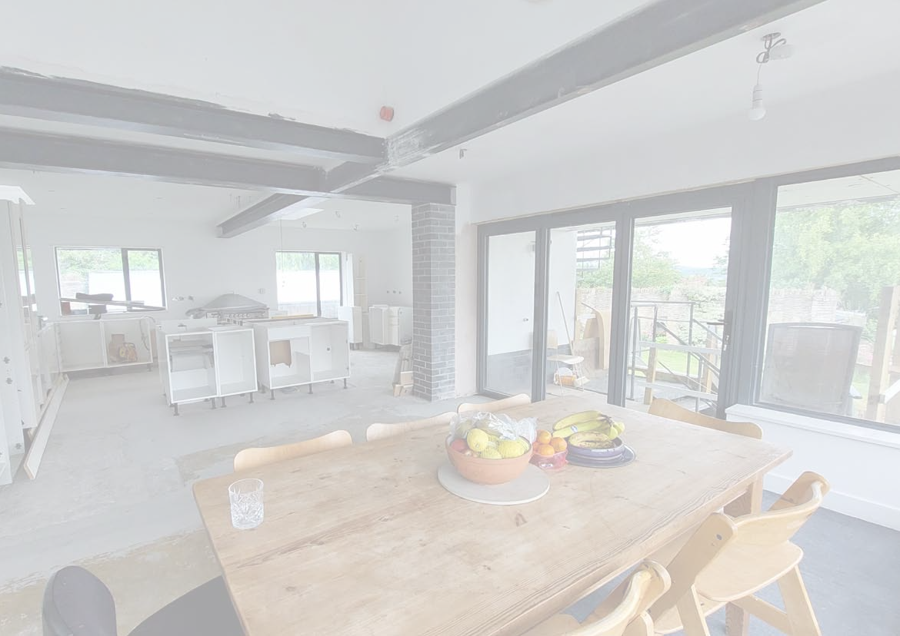
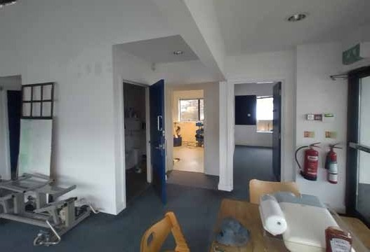
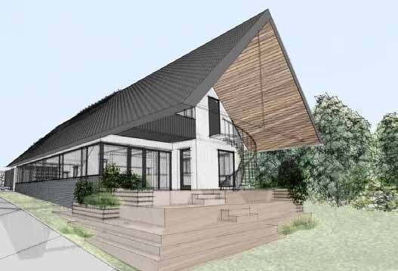
Louise & Gabe’s House. Locks Hill, Frome. Repurposing Medical Centre as a Family Home
PAAD
Architects
Limited
• Planning change of use from doctors surgery to single family home.
• No extension. Interior remodelling and minor elevational changes.
• Creative reuse of existing fixtures and fittings.
• Construction Costs: £750m².
T 01373 455500
E office@pa-ad.co.uk
W www.pa-ad.co.uk
Registered Office Address: 43 Poole Road, Westbourne, Bournemouth, BH4 9DN.
Registered in England & Wales.

Slide 13
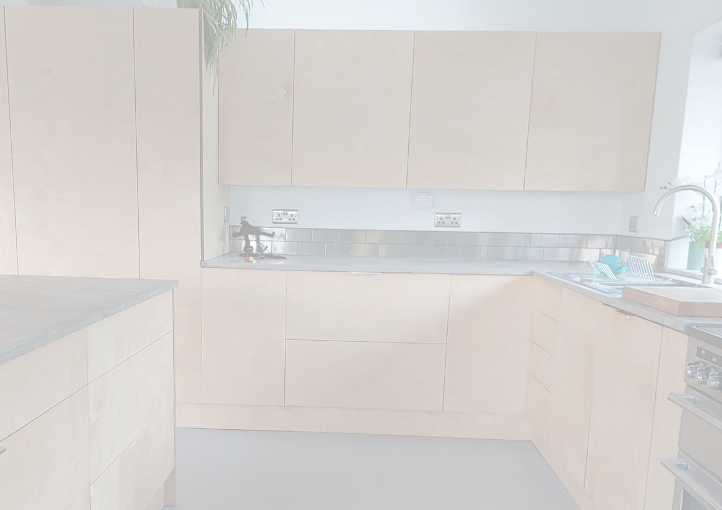
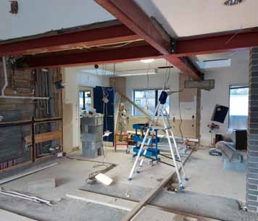
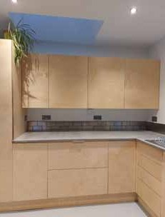
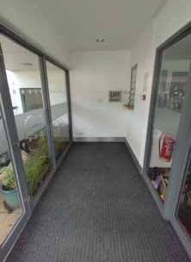
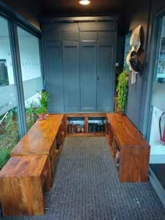
PAAD
^{Architects} CONSTRUCTION
Limited
• Minimal intervention with external envelope.
• Steelwork to open up floor plan.
• New triple glazed sliding doors.
• New roof lights to bring in natural daylight.
• Decoration and interior fit-out.
T 01373 455500
E office@pa-ad.co.uk
W www.pa-ad.co.uk
Registered Office Address: 43 Poole Road, Westbourne, Bournemouth, BH4 9DN.
Registered in England & Wales.

Slide 14
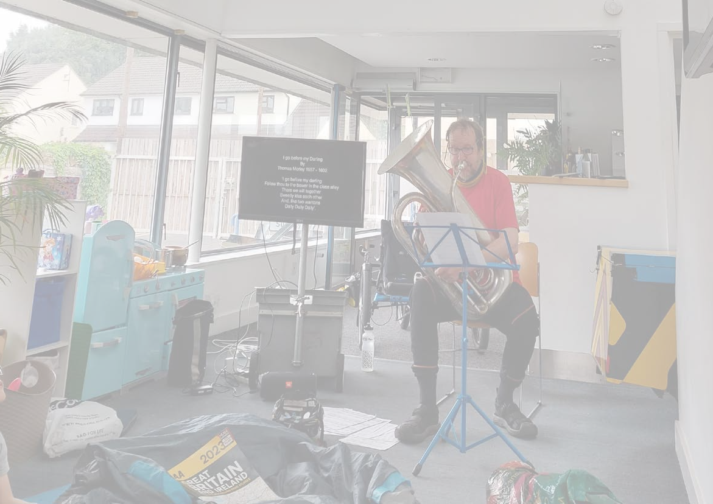
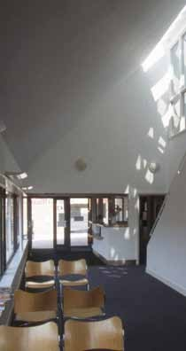
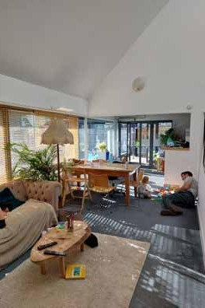
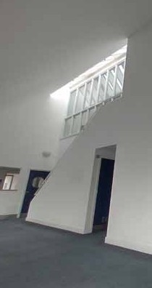

PAAD
Architects
Limited
ENERGY
• Reuse of existing gas boiler and PV panels.
• Minimise energy loss with blinds, carpets and rugs
T 01373 455500
E office@pa-ad.co.uk
W www.pa-ad.co.uk
Registered Office Address: 43 Poole Road, Westbourne, Bournemouth, BH4 9DN.
Registered in England & Wales.

Slide 15




PAAD
Architects
Limited
OTHER SUSTAINABILITY MEASURES
• Due to the fact that minimal intervention have occurred, Louise has added quirk and joy with what they have done.
T 01373 455500
E office@pa-ad.co.uk
W www.pa-ad.co.uk
Registered Office Address: 43 Poole Road, Westbourne, Bournemouth, BH4 9DN.
Registered in England & Wales.

Slide 16






PAAD
Architects
Limited
Homestead Farmhouse, Bridport.
T 01373 455500
E office@pa-ad.co.uk
W www.pa-ad.co.uk
Registered Office Address: 43 Poole Road, Westbourne, Bournemouth, BH4 9DN.
Registered in England & Wales.

Slide 17




PAAD
Architects
Limited
Church Road, Heywood. Passivehaus.
T 01373 455500
E office@pa-ad.co.uk
W www.pa-ad.co.uk
Registered Office Address: 43 Poole Road, Westbourne, Bournemouth, BH4 9DN.
Registered in England & Wales.

Slide 18





PAAD
Architects
Limited
Iffley Turn, Oxford
T 01373 455500
E office@pa-ad.co.uk
W www.pa-ad.co.uk
Registered Office Address: 43 Poole Road, Westbourne, Bournemouth, BH4 9DN.
Registered in England & Wales.

Slide 19






Architects 33 Somerset Road,
Limited _{Frome}
PAAD
T 01373 455500
E office@pa-ad.co.uk
W www.pa-ad.co.uk
Registered Office Address: 43 Poole Road, Westbourne, Bournemouth, BH4 9DN.
Registered in England & Wales.

Slide 20







Various Low Carbon Homes
PAAD
Architects
Limited
T 01373 455500
E office@pa-ad.co.uk
W www.pa-ad.co.uk
Registered Office Address: 43 Poole Road, Westbourne, Bournemouth, BH4 9DN.
Registered in England & Wales.

