Slide 1
Climate & Sustainability
June 2023
Cllr Sarah Dyke
Lead member for Environment & Climate Change

Slide 2
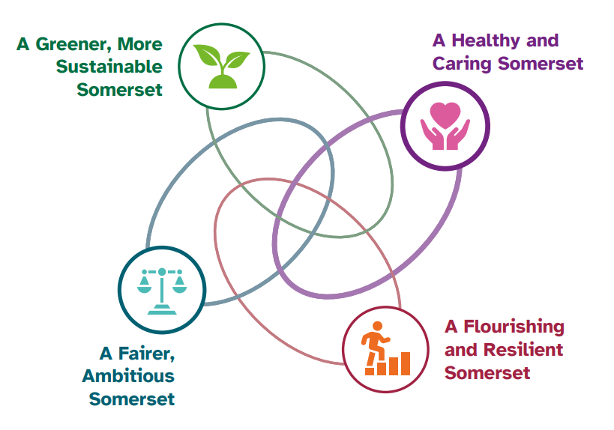
Introduction
Council Plan 2023-27
Our vision:
Somerset Council will build a fairer, greener, resilient, more flourishing Somerset that cares for the most vulnerable and listens to you.
Notes:
The 1st April 2023 saw the biggest changes to local government in Somerset since 1974 with the creation of the new Somerset Council.
The formation of the new, single tier, unitary council provides us with a unique opportunity to shape the future of Somerset for generations; to make it a more pleasant place to live and visit whist addressing both the climate and ecological emergencies at a county level.
The new council is committed to delivering against these ambitions and as such, they are implicit within the four stated priorities of the new Council Plan, namely:
A greener, more sustainable Somerset
A Healthy and caring Somerset
A fairer, ambitious Somerset
And a flourishing and resilient Somerset
These four priorities, alongside the Goals of the county-wide Climate Emergency Strategy, which was adopted in 2020, will form the strategic context and backdrop to our response to the climate and ecological emergency.

Slide 3
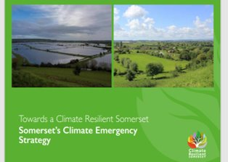
Climate Emergency Strategy
Towards a Climate Resilient Somerset
Goals and Outcomes of the Strategy
  Goal 1: To decarbonise Local Authorities, the wider public sector estates and reduce our carbon footprint
  Goal 2: To work towards making Somerset a Carbon Neutral County by 2030
  Goal 3: To have a Somerset which is prepared for, and resilient to, the impacts of Climate Change
Notes:
Towards a Climate Resilient Somerset is Somerset’s Climate Emergency Strategy which was co-produced by Somerset County Council, the four District Councils and industry experts in response to the Climate Emergency declaration.
The Goals of the Strategy are:
Goal 1: To decarbonise Local Authorities, the wider public sector estates and reduce our carbon footprint
Goal 2: To work towards making Somerset a Carbon Neutral County by 2030
Goal 3: To have a Somerset which is prepared for, and resilient to, the impacts of Climate Change
The strategy sets out 9 different workstreams (Energy, Transport, Built Environment, Business & Supply Chain, Natural Environment, Farming and Food, Water, Waste & Resources, Communications) which will work towards delivering 63 outcomes highlighted within the strategy.
Over the coming months we will be updating the county-wide climate emergency strategy to reflect that the ecological emergency has an equal weighting to the carbon reduction imperative and initiatives in our focus to address the immediate and future risks of climate change and our ecological crisis.

Slide 4
Climate & Place
A New Directorate
Climate & Place
Climate, Environment and Sustainability
Infrastructure and Transport
Economy, Employment and Planning
Notes:
To enable us to understand our own Council’s impact on the environment, we must understand where our carbon emissions come from and where we can make reductions in those emissions to help us become net zero by our 2030 target.
We have been working with consultants CGI Ltd to bring together all of the data from the previous district and county councils in areas such as our electricity and gas consumption across our estate and operations, staff and Cllr commuting, business travel, water consumption and waste to create a new baseline of carbon emissions.
We are backdating the calculation to 2018/19 as this was the year that all the Councils in Somerset declared or recognised the climate emergency. We have adopted a single methodology for consistency of data using the Local Government Association Greenhouse Gas Accounting Tool.
Work continues on establishing our overall carbon footprint which will enable us to develop further our plans around estate decarbonisation and electrification of fleet and travel as we work towards net zero.

Slide 5

Our Carbon Footprint
Creation of a baseline for Somerset Council
CE Strategy Goal 1: To decarbonise the Local Authority and public sector estates and reduce our carbon footprint
Baseline year 2018/19
Use of the LGA Greenhouse Gas Accounting Tool
Notes:
To enable us to understand our own Council’s impact on the environment, we must understand where our carbon emissions come from and where we can make reductions in those emissions to help us become net zero by our 2030 target.
We have been working with consultants CGI Ltd to bring together all of the data from the previous district and county councils in areas such as our electricity and gas consumption across our estate and operations, staff and Cllr commuting, business travel, water consumption and waste to create a new baseline of carbon emissions.
We are backdating the calculation to 2018/19 as this was the year that all the Councils in Somerset declared or recognised the climate emergency. We have adopted a single methodology for consistency of data using the Local Government Association Greenhouse Gas Accounting Tool.
Work continues on establishing our overall carbon footprint which will enable us to develop further our plans around estate decarbonisation and electrification of fleet and travel as we work towards net zero.

Slide 6
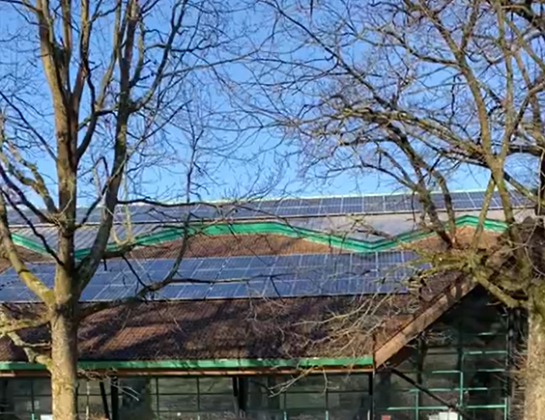
PSDS
Public Sector Decarbonisation Scheme
The scheme is to improve environmental efficiency of public sector building and has currently funded the installation of solar panels, Air Source Heat Pumps, VRF cooling systems and increased LED lighting at several sites across the County.
Notes:
Past councils:
List of sites that benefitted from PSDS:
Westlands - solar array, VRF system (cooling)
Goldenstones - solar array, ASHP, increased led lighting
Wincanton Leisure Centre - solar array, ASHP
Wellington Sports Centre
Alcombe Childrens Centre
New council:
Plan moving forward???
The plans to introduce Air Source Heat Pumps at all three leisure centre sites (currently they have been installed at two), will increase the CO2 reductions to 435 tonnes, which is the equivalent to taking 229 cars off the road!

Slide 7

Retrofit
Somerset Retrofit Accelerator
The project aims to develop the supply chain for low carbon, whole house retrofitting of homes in Somerset through:
50 discounted Home Retrofit plans for Somerset households
30 paid places on course for local construction professionals
Creating new online resources through a Green Directory for Somerset
Showcasing low carbon homes through virtual online tours
Notes:
Retrofit
The Somerset Retrofit Accelerator project is a partnership between Frome, Bruton and Glastonbury Town Councils, Somerset Council, Somerset Independence Plus and the Centre for Sustainable Energy.
The one-year pilot project is funded by the UK Government through the UK Community Renewal Fund.
The project aims to develop the supply chain for low carbon, whole house retrofitting of homes in Somerset through:
50 discounted Home Retrofit plans for Somerset households in partnership with Futureproof. These plans will be based on your needs, aspirations for your homes and budget, and will help you understand what measures may be the most appropriate and impactful for your home.
30 paid places on the Futureproof Essentials course for local construction professionals. Learners will benefit from training which provides cornerstone knowledge on the key aspects of sustainable construction and retrofit.
Creating new online resources through a Green Directory for Somerset
Showcasing low carbon homes through virtual online tours which can be viewed on the retrofit somerset website.
The one-year pilot project is funded by the UK Government through the UK Community Renewal Fund.

Slide 8

Local Area Energy Plan
Working alongside Regen to develop a Somerset Wide Energy Plan to:
Assess renewable opportunities
Explore opportunities for renewables on council owned assets
Create a map of renewable energy opportunities
Map unavoidable and subjective constraints
Identify investment projects and opportunities
Roadmap towards objectives in the Somerset Climate Emergency Strategy including
  A target of net zero by 2030
  Work with stakeholders to invest and grow renewable energy in Somerset
Notes:
Working alongside Regen to develop a Somerset Wide Energy Plan with the following objectives
Develop a high-level assessment of renewable opportunities to support the development of the new Somerset wide Local Plan
Explore opportunities for renewables on council owned assets
Detail current renewable energy generation and an area-wide map of renewable energy opportunities
Map high-level assessments of unavoidable constraints and subjective constraints
Identify investment projects and opportunities
A roadmap towards the objectives outlined in the Somerset Climate Emergency Strategy including a target of net zero by 2030 and how to work alongside stakeholders to invest and grow renewable energy generation in Somerset.
Local Area Energy Planning is a transparent, data driven, and evidence-based approach that sets out to identify the most effective route to contribute towards meeting the national and local targets of net zero.

Slide 9
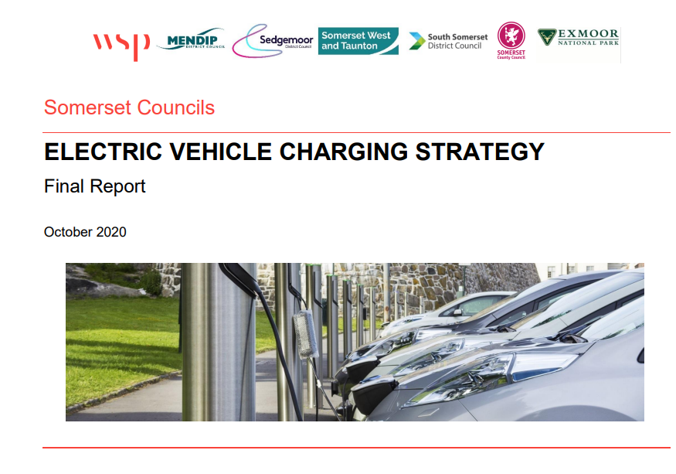

Electric Vehicle Charging
EV Strategy
SCC and the four district councils approved the countywide EV Strategy in 2020/21
Since then, the district councils have installed several charge points across somerset
LEVI Fund
Going forward Somerset Council is to be allocated £3.7m of LEVI capital funding. ​
​
The LEVI fund aims to deliver a step change in the deployment of local, primarily low power (7kW standard and 22kW fast) public charge points, that will help residents who do not have access to off street parking and need to charge their vehicle. ​
​
LEVI has a three-step process:​
  Expression of Interest, which we submitted 26 May 23​
  Business Case/Draft Tender Documentation to be submitted by 17 Nov 23 ​
  Contract Review – Summer 24
The LEVI scheme is made easier by being part of a single council
We have retained the skills and experience from previous roll outs that will benefit the LEVI programme going forward ​
Notes:
We are also creating a specific EV Charging Infrastructure webpage which will include Government policy, the existing Somerset Council EV strategy, our programme of work and links to EV charging location data and funding opportunities. The webpage will evolve and be developed over time. We will also use it to interact with our residents, business owners, as well as parish and town councils.

Slide 10
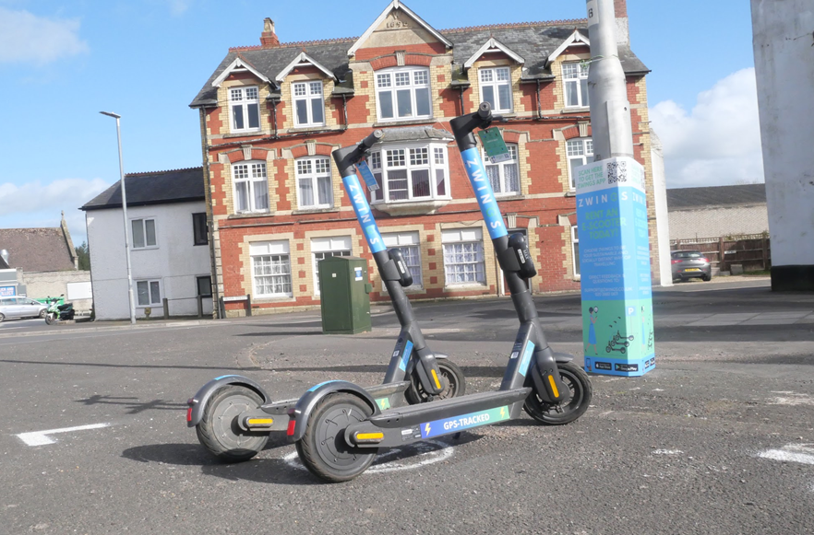
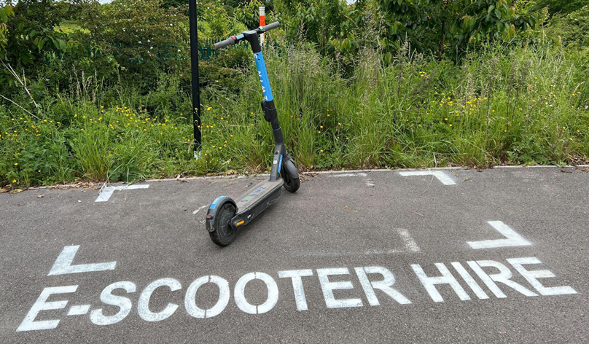
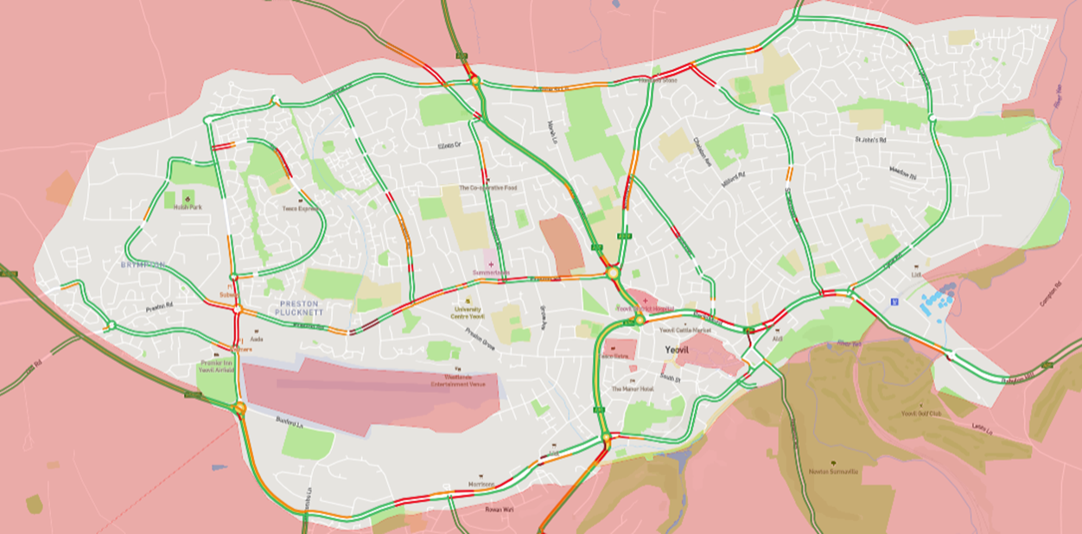
E-Scooters
E-Scooter Trials
Uptake in Yeovil has been positive, with over 75,000 rides made covering over 160,000 miles since the launch.
Around 22% of e-scooter journeys in Yeovil replaced car travel (12,760 journeys).
In SW&T, there has been over 120,000 rides covering 228,500 miles.
Notes:
E-scooters, on average, emit 35g/km across their lifespan, compared to 200-350g/km for private petrol cars.
E-scooters being used in both trials are limited to 15mph, though other models available commercially can exceed 30mph
E-scooters remain illegal on UK roads outside of the current trial areas
Somerset West and Taunton:
Contract with Zipp Mobility, extended till 2024
121,750 rides by nearly 15,000 riders, travelling more than 228,500 miles
South Somerset:
Contract with Zwings, extended till 2024
Yeovil Trial Zone: Low Speed Areas, and no scooting areas
Designated parking bays
In SW&T there have been over 120,000 rides made by nearly 15,000 different users covering a distance of 228,500 miles.
In Yeovil, there have been 75,000 rides made covering over 160,000 miles since the launch
Impact of e-scooters
Lower Co2
More inclusive transport (convenient, affordable)
Improving mental and physical health (fresh air, cleaner air, physical activity being on a scooter)
Replacing car journeys
Improving space usage (10 scooters to 1 car)
Low emission operations (using renewable electricity, and using electric vans)

Slide 11
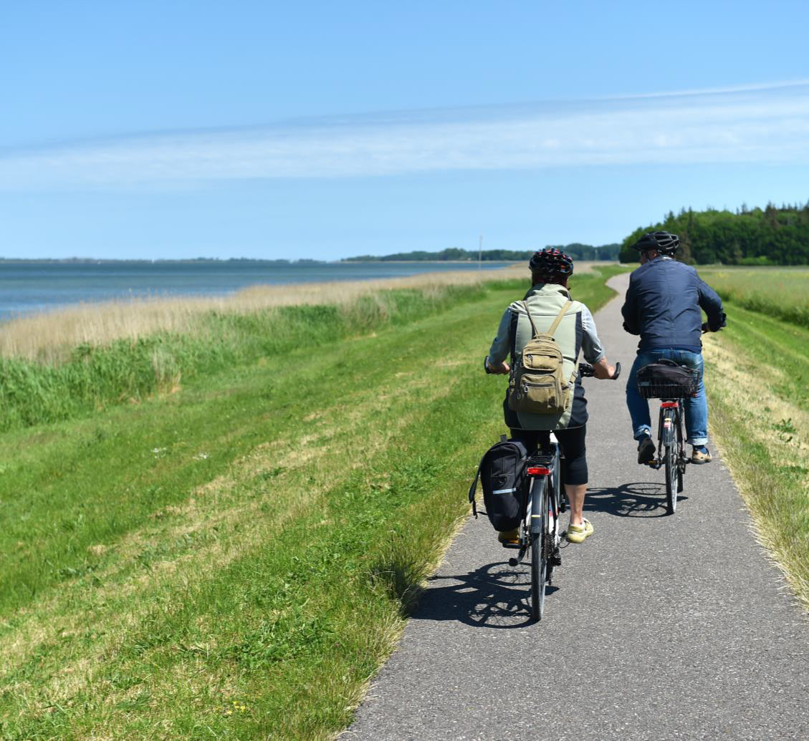
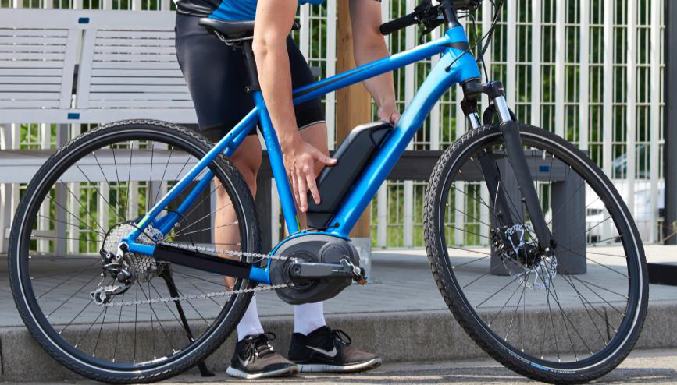
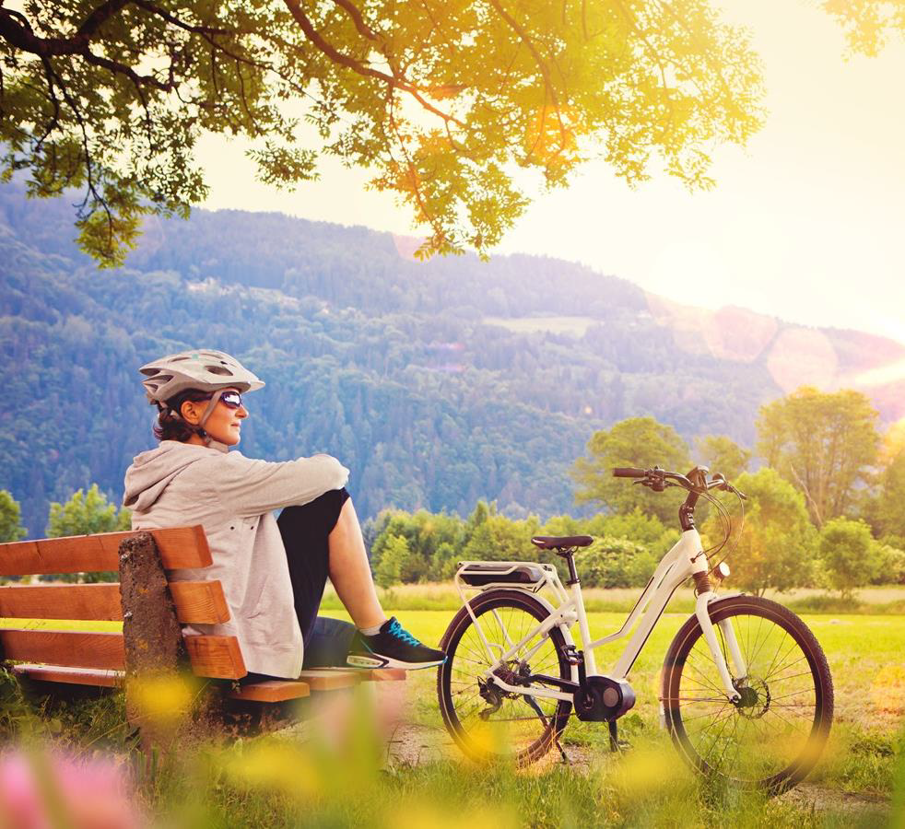
E-Bikes
E-Bike Strategy
The vision is that by 2035, Somerset will create an environment that supports the use of e-bikes and e-cargo bikes.
The Somerset E-bike Strategy has been drafted and is in its final stages before publication; setting out objectives, investment and funding to prioritise e-bike opportunities across Somerset.
Notes:
The objectives of the strategy are:
1.Capturing their potential to transform Somerset’s future mobility mix, e-bikes and e-cargo bikes will be fully integrated into transport network.
2.By presenting a safe, suitable, and convenient mode of transport, e-bikes and e-cargo bikes will support a reduction of carbon emissions and contribute to the overall decarbonisation of Somerset’s mobility mix by supporting modal shift away from carbon-emitting modes.
3.E-bikes and e-cargo bikes will support a growing economy by creating new opportunities for business, through sales, rentals and more.
4.E-bikes and e-cargo bikes will support green economic growth by providing businesses with low-emission, lower impact alternatives for deliveries and operations.
5.E-bikes and e-cargo bikes will contribute to a reduction in pollution, emissions, and in particular will support clean air goals in Air Quality Management Areas.
6.E-bikes and e-cargo bikes will contribute to public health through supporting active travel in the mobility mix.
7.E-bikes and e-cargo bikes will offer an affordable and reliable transport option with low operational costs.
8.E-bikesand e-cargo bikes will enable anyone to become a cyclist irrespective of ability.
E-bikes are currently inaccessible to a many people for a number of reasons including cost, not having safe storage space, or simply due to lack of awareness,to name a few. Through engagement with a range of stakeholders across different sectors, we have identified the key barriers to adoption and developed a set of targeted proposals aimed at accelerating the change.
Somerset e-bike and e-cargo bike 2035 vision
“By 2035, Somerset will create an environment that supports the use of e-bikes and e-cargo bikes. Representing a central part of the mobility mix, use of e-bikes and e-cargo bikes will be commonplace across the county for people and organisations alike, inclusive of all.
Benefits of e-bikes:
Shared e-bike scheme enables access to convenient, flexible, cost-effective transport that can work around a person’s schedule, rather than having to rely on public transport alone
The try-before you buy scheme, allows an individual to secure a short-term loan of an e-bike free of charge
Enables residents who would otherwise not access bicycles to stay active (especially elderly or less mobile residents)
Allows businesses to avoid congestion and park closer to clients, resulting in lower overheads and increased revenue for business, and additional flexibility.
As we work towards achieving net zero by 2050, wide-ranging changes to transport will be needed. To reach our decarbonisation targets, we will need to do more than just switch to electric vehicles. In the coming decades, we need to create a shift further away from travelling using a private car and move towards more sustainable modes of transport which include E-bikes. These have a significant role to play in bringing about this change, especially in decarbonising shorter journeys that are currently made by car, and in providing better connections with the public transport network to travel longer distances. By making cycling easier, more accessible and more enjoyable, e-bikes can help to accelerate this change.
Electric bikes, or electrically assisted pedal cycles (EAPCs), come in a range of shapes, sizes and specifications, but fundamentally they all offer an improved riding experience over that of a traditional self -powered pedal cycle by providing electrical assistance using a battery and electric motor. Recent developments in the technology have enabled batteries to become smaller and therefore lighter, and electric motors have become more efficient. Together, these advances have led to the development of extremely capable electric bikes, and they are becoming gradually more affordable. Much like self -powered pedal cycles, e -bikes are available in a range of styles and specifications to suit different budgets and requirements. Increasingly, e -cargo bikes are becoming popularised as an alternative to vans for delivery and servicing activities in urban areas, whilst having minimal impact on the quality of the local area and the environment. They are also used by families as an alternative to a car to enable them to carry shopping and small children, using their additional cargo carrying capacity.
The vision for Somerset set out in the E-bike Strategy is that by 2035, Somerset will create an environment that supports the use of e-bikes and e-cargo bikes. Representing a central part of the mobility mix, use of e-bikes and e-cargo bikes will be commonplace across the county for people and organisations alike, inclusive of all.
The Somerset E-bike Strategy has been drafted and is in its final stages before publication and launch; setting out clear objectives for the next steps and prioritising investment and funding to prioritise e-bike opportunities across Somerset.
Electric bikes, or electrically assisted pedal cycles (EAPCs), come in a range of shapes, sizes and specifications, but fundamentally they all offer an improved riding experience over that of a traditional self -powered pedal cycle by providing electrical assistance using a battery and electric motor. Recent developments in the technology have enabled batteries to become smaller and therefore lighter, and electric motors have become more efficient. Together, these advances have led to the development of extremely capable electric bikes, and they are becoming gradually more affordable. Much like self -powered pedal cycles, e -bikes are available in a range of styles and specifications to suit different budgets and requirements.

Slide 12
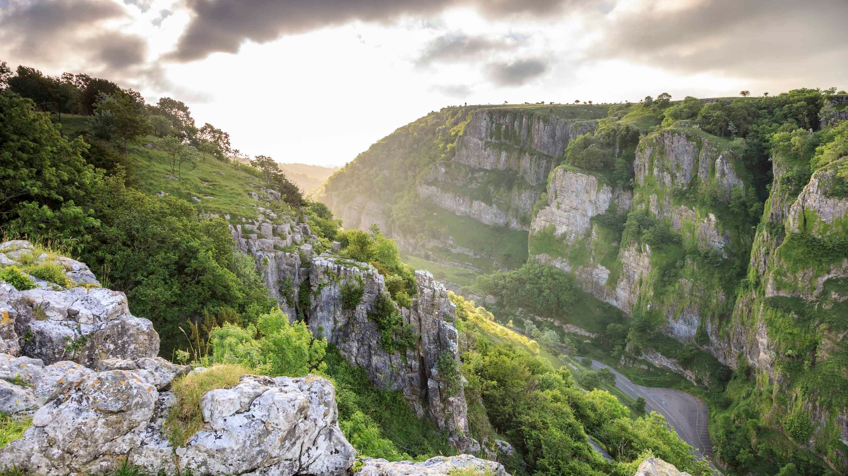
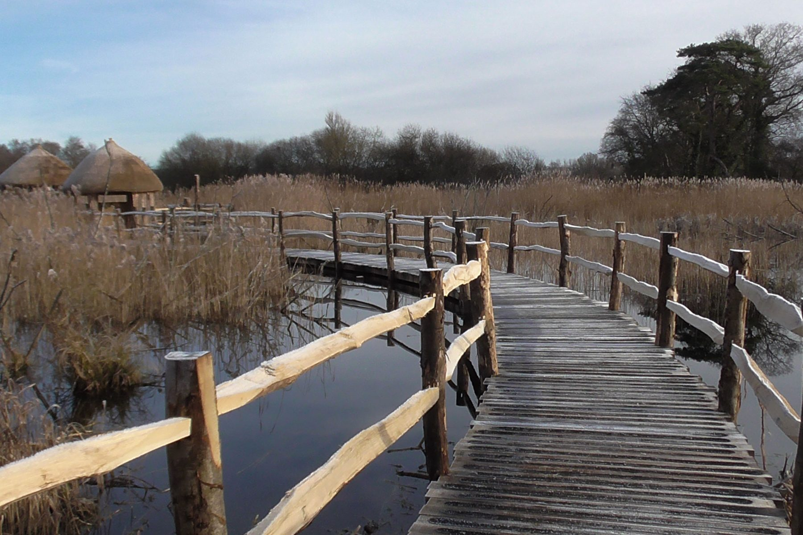
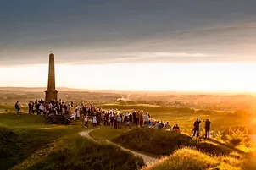
Green Tourism
Somerset is a haven for green holidays – cycling, walking and wildlife watching in our beautiful County
Officers across Tourism and Economic Development work with businesses to ensure they have considered the carbon impact of their business, enabling them to offer the lowest impact holidays.
Green itineraries are being developed to offer visitors lower impact stays.
Notes:
The county is blessed with significant natural assets that often form the core of a visitor itinerary. The Somerset Levels and Moors including attractions like the Avalon Marshes, and on the coast is the Bridgwater Bay NNR, for those seeking wildlife spotting opportunities. More broadly locations like Cheddar Gorge and Ham Hill include sites of geological interest, whilst Exmoor National Park’s landscape delivers iconic walking routes. The extensive Rights of Way network, and presence of both regional (River Parrett Trail) and national (southwest coast path) trails brings people to the county for walking holidays. New cycle routes, making use of the Sustrans network, are also popular downloads with new routes in development.
Officers across Tourism and Economic Development teams work with businesses to ensure they are positioned to support visitors, like those on a walking holiday, and that they have considered the carbon impact of their business and are able to measure and then address it, offering the lowest impact holidays.
For the future, green itineraries are being developed to offer visitors lower impact stays with both suggested attractions to visit and information on infrastructure like the EV charging networks.

Slide 13

Biodiversity Net Gain
Biodiversity Net Gain is a new system to ensure that land is developed in a way that contributes to the recovery of nature.
The planning and ecological services teams are working together to consider the best options for the county, taking advice from nature conservation partners and landowners.
A new adopted system will be in place by November
this year
Notes:
Biodiversity Net Gain is a new system being implemented by government to ensure that land is developed in a way that contributes to the recovery of nature. It aims to ensure that habitats for wildlife are in a better state after a new development, than before. As a local planning authority Somerset Council needs to show it has a system in place by November of this year to help manage BNG.
The system works through units, with developers having to fund a number of units dependent on the location and scale of their development. Ideally BNG credits are delivered on site, so nature can thrive in its original location, however the quantifiable system allows developers to buy BNG units off site when required. Somerset Council wants to ensure as many BNG credits are kept in Somerset as possible – ensuring investment in our nature recovery plans, building resident habitats.
The planning and ecological services teams are working together to consider the best options for the county, taking advice from nature conservation partners and landowners.
Some of our land is begin reviewed for baseline BNG assessments so we can see what units could be accepted on the land to enhance them for nature in the future.

Slide 14
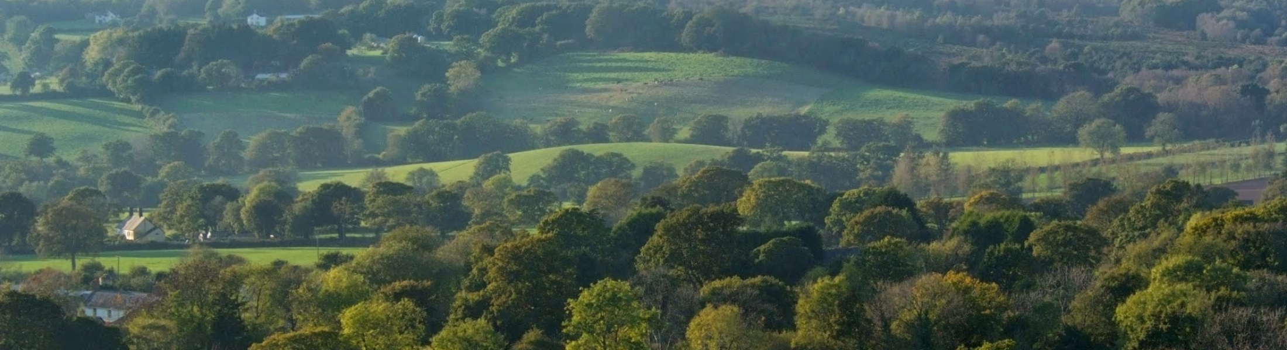
Local Nature Recovery Strategy
With the Local Nature Partnership
A flagship measure of the Environment Act, which will establish the priorities and nature recovery network maps for specific actions to drive nature’s recovery across Somerset
Notes:
Local Nature Recovery Strategies (LNRS) are a new approach to setting priorities for nature at a local level in England. They are a statutory requirement, defined in Sections 104 to 106 of the Environment Act 2021.
Preparatory work in Somerset is being co-ordinated through the Somerset Local Nature Partnership. The information we have on the state of nature in Somerset is being updated, ensuring we have sound evidence from which to identify new priorities. Maps of our core nature sites and opportunities areas are being updated and supplemented with new mapping on how they can be better connected across our landscapes and with people, creating our ‘nature recovery network’. We are meeting with a range of organisations and partnerships to collate baseline information, understand their needs and expectations from the LNRS, and involve them closely on its development.
We anticipate that it will be completed in mid 2024.
How will the LNRS be used in Somerset?
It will provide local planning authorities and developers with information to enhance the planning system, including the delivery of Biodiversity Net Gain requirements, and investment in our urban green spaces. It will guide public and private investment, including through the new Environmental Land Management Schemes (ELMS). It will support communities and businesses in their actions to protect and enhance Somerset’s land and marine environments, and the benefits we gain from them, such as health, access and learning.

Slide 15
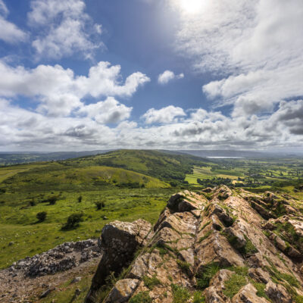
Countryside & AONB Services
The Somerset Council Countryside Service manages 282 Ha of land across 6 natural greenspaces.
The ranger team have responsibility for protected species and habitats, site designations, and safe public access.
Areas of Outstanding Natural Beauty
Somerset is home to part of four AONBs; The Mendip Hills, Cranborne Chase & West Wiltshire Downs, Blackdown Hills and the Quantock Hills.
The Mendip and Quantock teams are hosted by Somerset Council.
Notes:
The Somerset Council Countryside Service manages 282 Ha of land across 6 natural greenspaces, from Country Parks to Local Nature Reserves in the South of Somerset. The team consists of 5 rangers and a community ranger who manage the sites to adopted management plans.
The three strategic sites are all Green Flag Award winners and Ham Hill Country Park is also a Green Heritage award holder. The ranger team have responsibility for protected species and habitats, site designations like SSSI’s and Scheduled Monuments and safe public access. All sites offer fantastic leisure and wellbeing opportunities for both residents and visitors alike. Rangers deliver a diverse events programme, from bat walks to easter trails, with further national curriculum linked school visits on top. A fantastic team of volunteers supports works at the largest sites, with nearly 3,000 days donated each year to maintaining and improving the countryside sites. Friends' groups at Ham Hill, Yeovil Country Park and Chard Reservoir all provide vital community and fundraising support.
Somerset is lucky enough to include at least part of four AONBs; The Mendip Hills, Cranborne Chase & West Wiltshire Downs, Blackdown Hills and the Quantock Hills. Representing key national landscapes these areas have management and ranger teams who work with landowners and communities to conserve the habitats, species, and the culture of the areas. The teams are pivotal to ensuring nature conservation, wellbeing initiatives, education programmes and visitor access is delivered in these special national landscapes, through adopted management plans, and newly emerging nature recovery strategies. The Mendip and Quantock teams are hosted by Somerset Council.

Slide 16
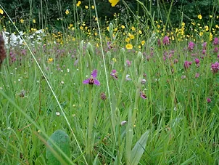
Grassland Management
Best practice from the five legacy councils is being considered and coordinated
Where safe, cutting of verges will be reduced to allow wildflowers to bloom.
High quality grassland verges will be identified as Roadside Nature Reserves
Strategic open spaces will have a 5-year management plan, which will include wilding areas.
Notes:
Best practice from across the five legacy councils is being considered and coordinated to form an adopted coherent packed for 2024. A grassland management approach for open spaces has been successfully rolled out in Somerset West and this will be reflected across the rest of the County at council owned and managed open spaces. The use of the spaces will be carefully considered and then, where appropriate, altered grass cutting regimes will be implemented to encourage growth of wildflowers, encouraging the associated mammal and invertebrate life.
On appropriate verges (where safety considerations have been ruled out) the cutting frequency will be reduced to allow wildflowers to bloom and later set seed. Where possible high quality grassland verges will be identified and mapped as Roadside Nature Reserves. These core plots will encourage the expansion of biodiversity throughout the verge network.
Strategic open spaces will have a five-year management plan that ensures nature conservation and community involvement is considered for the space. In these strategic open spaces wilding areas will be set aside to allow nature to flourish. Some interventions may be delivered to enhance plant species, and a cut and remove in the high summer / early autumn will be the mechanism of choice where equipment can access the site.
A programme of communications will be rolled out to explain the change in management approaches that residents will notice. Signage and communications to parishes will inform communities about the changes they will see in their local environment and the reasons behind the changes.

Slide 17






Tree Strategy
A Tree Strategy for everyone in Somerset
Developed in Partnership with a wide range of stakeholders the strategy focuses on 5 key themes
Creating a woodland culture
Making our treescapes more resilient and adaptable to climate change
Expanding tree coverage across Somerset
Focusing on the services and products around trees
Creating a sustainable and flexible governance structure
Notes:
Our tree strategy will provide a strategic framework to increase tree canopy cover across the county, ensuring the right tree, right place, right pace, ethos is followed.
Whilst some areas of the county are generally heavily wooded, Somerset’s tree cover currently sits at around 8% of the county – the national average is 13% and the national target is 14%.
Benefits of increasing the canopy cover include:
Purification of water sources
Increased production of sustainable building materials
Increased air quality
Climate Change adaptation such as shade for people and livestock during hotter summers
Increased biodiversity
Reducing the impacts of surface water runoff and flooding
Plus increasing the health and wellbeing benefits of access to nature.
Work is already underway with the creation of three new posts, funded through a successful bid to Defra’s Woodland Creation Accelerator Fund. With tasks including supporting existing tree groups and encouraging new ones, these roles are expected to be in place by the beginning of the summer - utilising £300k of funding gained from the Woodland Creation Accelerator Fund to deliver on the strategy.

Slide 18
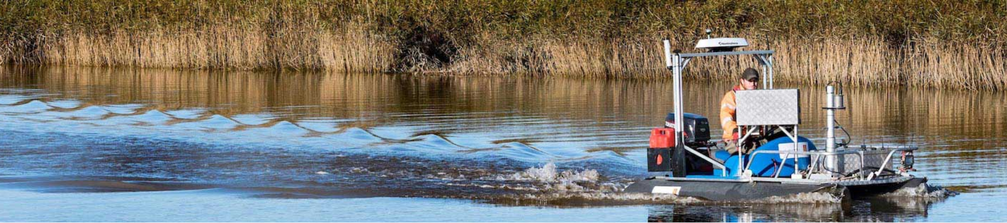
Flooding
Lead Local Flood Authority
Somerset Council is the Lead Local Flood Authority for Somerset, which means they lead in managing local flood risks
LLFA’s are required to prepare and maintain a strategy for local flood risk management, coordinate with other local bodies and communities.
Notes:
Somerset Council is the Lead Local Flood Authority for Somerset, which means they lead in managing local flood risks (i.e. risks of flooding from surface water, ground water and smaller watercourses).
LLFA’s are required to prepare and maintain a strategy for local flood risk management in their areas, coordinate views and activity with other local bodies and communities through public consultation and scrutiny, and delivery planning.
Flooding is an habitual risk to many of us within the county which is only due to get worse as rain patterns and water levels change due to climate change, but learning from a number of projects that we spearheaded here in Somerset, including Co-Adapt and Triple C, we can influence better land-use and champion Natural Flood Management techniques that not only reduce flood risk but increase biodiversity and address water quality issues.
The SRA is a partnership between Somerset Council, the local internal drainage boards, the Environment Agency, Natural England and Wessex Regional Flood & Coastal Commitee. Only in Somerset do partners work so closely together to tackle flooding problems.
Another project part funded by the SRA is the brand-new Climate Adaption toolkit by Adapting the Levels. This toolkit is designed to share the Adapting the Levels project’s knowledge and messages across Somerset, leaving a legacy of empowering communities to adapt to climate change.

Slide 19
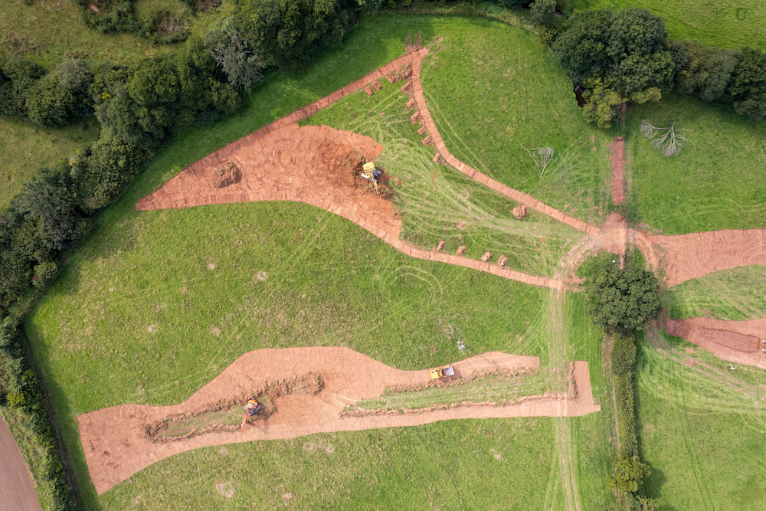
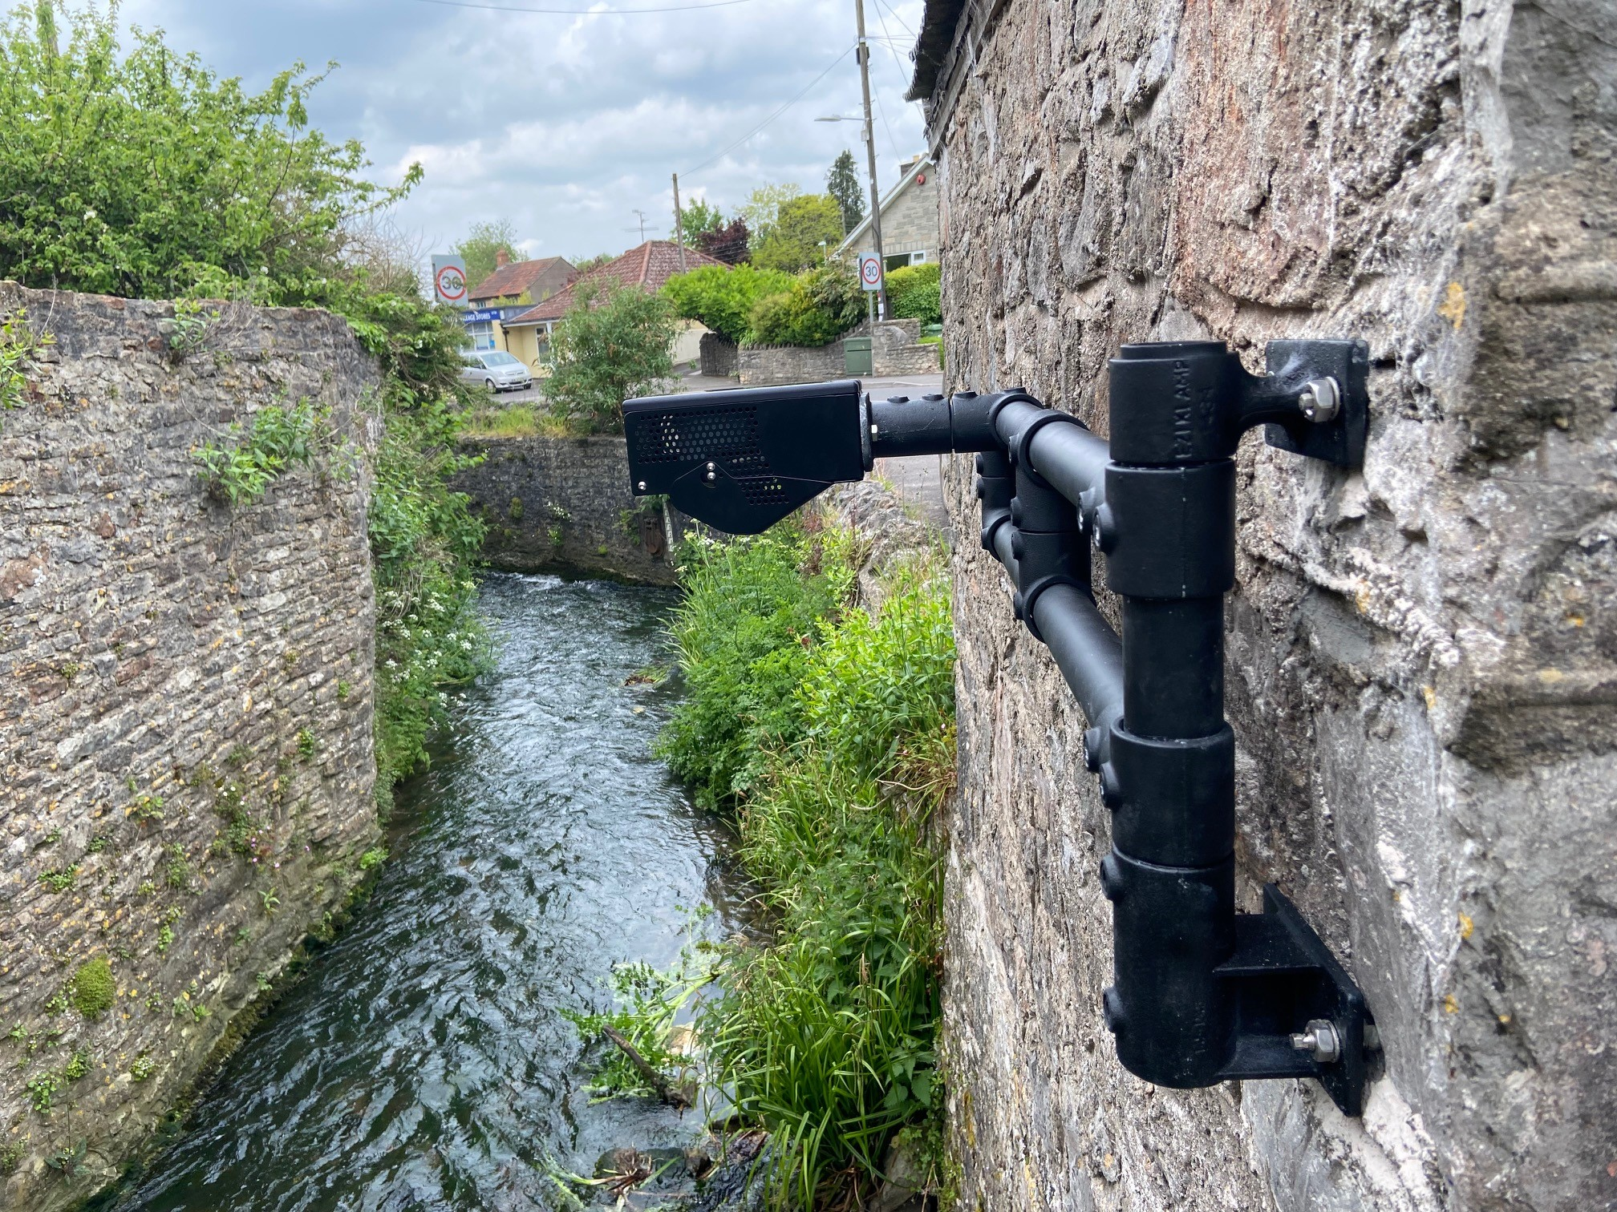
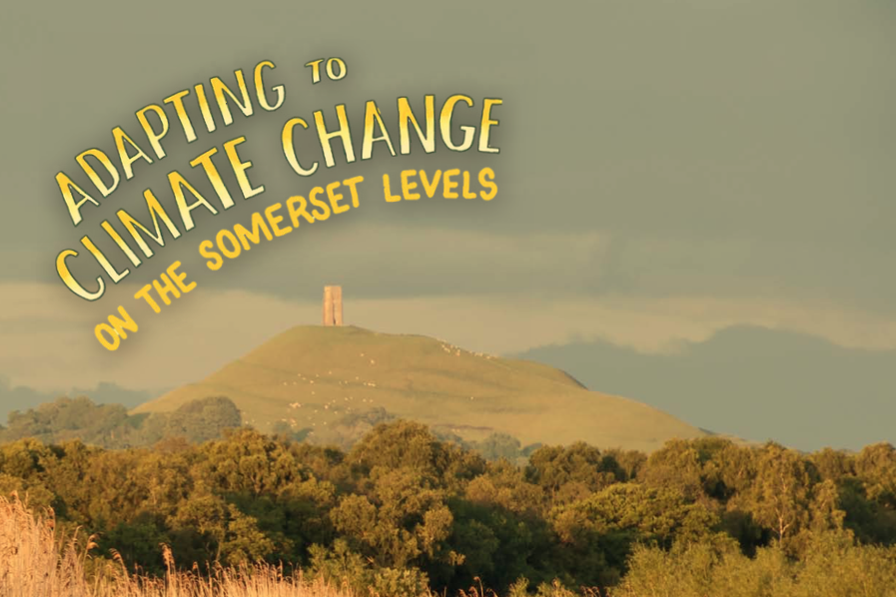
Somerset Rivers Authority
Unique partnership. Extra Somerset flood protection
- Approved funding for 250+ projects since launch in 2015
- Long-term policy aim to address Climate Emergency through projects which increase resilience and encourage adaptation
- e.g. river and stream restorations, community initiatives
Notes:
1. Policy as stated in Appendix 7 of SRA MoU for 2023-24, about SRA Grant Guidelines, Paragraph 3, The long view, e) “Addressing the Climate Emergency – to encourage projects which directly support Somerset’s response to climate change by increasing resilience and encouraging adaptation to the effects of climate change”.
2. First picture shows scheme of national interest and significance part-funded by the SRA, the ongoing ‘Stage 0’ river restoration work on the National Trust’s Holnicote estate in West Somerset. There is more about this on pages 8-9 of the draft SRA Annual Report 2022-23, which Cllr Dyke has a copy of. Sample quote: “It will help to tackle the impacts of climate change by holding water in the landscape.” There is also a long news story about this on the SRA website: A UK first for Somerset as Exmoor river floodplain restored - Somerset Rivers Authority
3. Second picture shows equipment being installed this year as part of a project to help communities respond better to flash flooding. The risks arising from this are expected to get more severe as downpours get more intense. Again featured in the SRA Annual Report 202-23 on page 29.
4. Fresh out a few weeks ago, part-funded by the SRA, was a 28-page Climate Adaptation Toolkit. More information on page 29 of the SRA Annual Report. A copy of the Toolkit can be downloaded at: Adapting to Climate Change on the Somerset Levels (adaptingthelevels.com)
5. If this same element of Adapting the Levels has previously been featured on another slide in this website, we suggest featuring Trees for Water instead. See pages 17-18 of the new Annual Report 2022-23 or look on the SRA website at, for example: Trees for Water Action Fund 2021-22 - Somerset Rivers Authority or Trees for Water - Somerset Rivers Authority Quite a few pics on these pages on the SRA website.

Slide 20
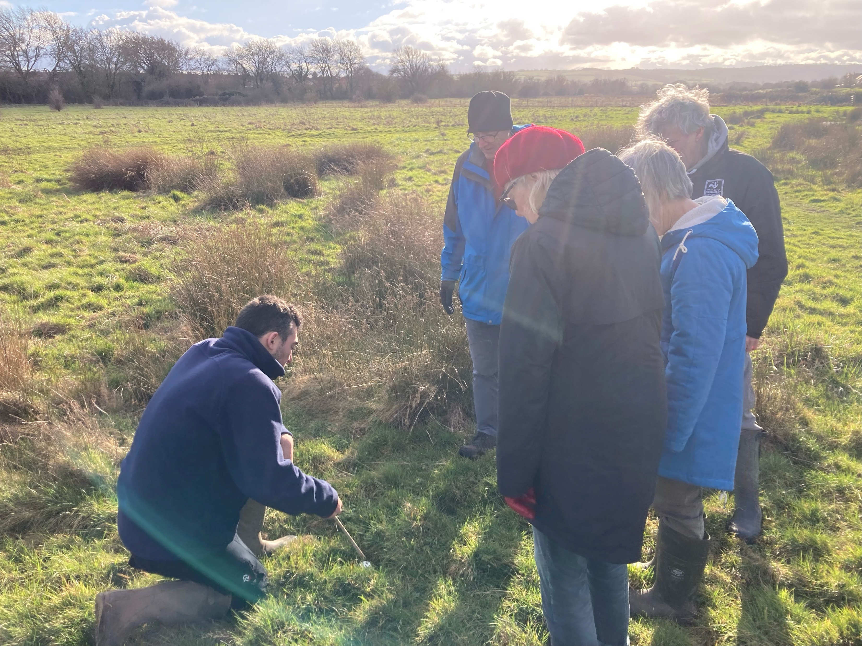
Environment Champions
Residents
Council officers
A space to discuss issues, share resources, learn from each other and experts, and share good practice across the council
Running events and providing resources and information to a network of residents, parish representatives and members of green groups
Want to get involved? Email us at climateemergency@somerset.gov.uk
Notes:
External Residents Environment Champions program
Schemes have been run in South Somerset and Sedgemoor District Councils, and will continue through the new council.
Regular events – online and in person
Resources and information for parishes, green groups and residents
Building resilience through educating communities about adaptation to the inevitable impacts of climate change
Opportunity for networking and sharing best practice
The Environment Champion network is a growing network of local residents, passionate about the environment. We share best practice and support each other to deliver local eco projects across the district. As part of the voluntary initiative, we aim to communicate national and local grant funding opportunities and provide seasonal resource packs to our Champions to help encourage your environmental plans.
We have run many events for our Environment Champions, with local speakers e.g. from SCAN, Green Wedmore, Local Nature Partnershp/Somerset Wildlife Trust, and a horticultural lecturer at Bridgwater College who gave a talk on ecology in the Steart Marshes in Sedgemoor. We also had our own officer speak about their Community Adaptation Toolkit at an in-person workshop in Othery Village Hall, which led to us being able to give advice to local rural halls on applications for the rural halls grant. Our last event in February 2023 was run with the Wetlands & Wildfowl Trust – an online presentation followed by an in-person workshop at the wetlands site in Bridgwater.
Internal Staff Environment Champions program
The network has previously been run at Sedgemoor District Council and South Somerset District Council. We are seeing officers from a range of service areas throughout the council, with backgrounds across all five previous councils.
The network will look to host semi-regular Climate Cafés to provide an opportunity to discuss issues, ask questions, learn from each other and experts, and share good practice across the council. The Teams channel also provides a space for officers to share information, resources, and have ongoing discussions about the topic.
This Staff Environment Champions network will run separately from the Community Of Practice, which will be about bringing in cross-council staff working on delivering the council's targets/aims and objectives. It will also be separate from the residents Environment Champions program, which will engage with members of the public and is in the process of being set up for the new council.

Slide 21
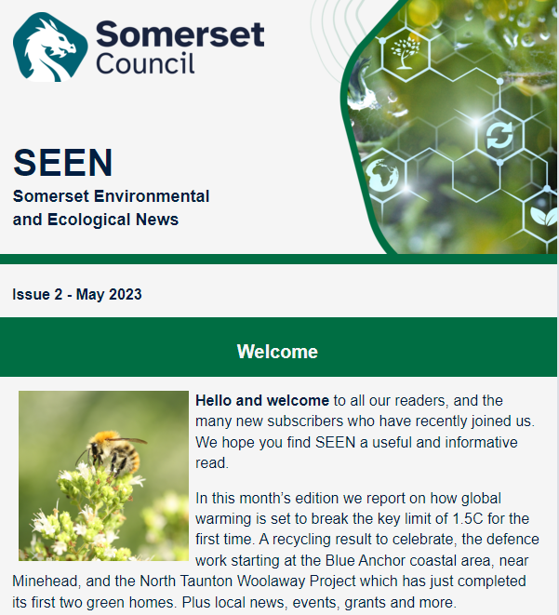
Newsletter
Somerset Environmental and Ecological News
Latest news
Local news
Your community
News from Somerset Council
Events and get involved
Resources and opportunities
Grants and funding
Media corner
Notes:
NEW COUNCIL:
In every edition, we share news and information to help support parishes, green groups and individuals in Somerset.
Each edition is published monthly, on the last Friday of the month.
There are 1282 subscribers, including parishes, local green groups, Environment Champions, interested residents.
The newsletter also goes out to all Somerset staff and councillors
Now writing the third edition. Goes out to subscribed residents across all Somerset areas.
Latest news
National/global climate news
Local news
Updates from organisations in Somerset
Your community
Achievements from local green groups
News from Somerset Council
Update on council climate work, important information, climate achievements
Events and get involved
Opportunities anyone can get involved in in the upcoming month
Resources and opportunities
Volunteering opportunities, information on adaptation
Grants and funding
Media corner
Book/podcast/film recommendations to learn more/delve deeper
PREVIOUS:
SSDC – Get SuSSed. 30 issues.
SDC – Sustainable Sedgemoor. 21 issues.
SWT – Somerset West & Taunton Climate News. 12 issues.

Slide 22
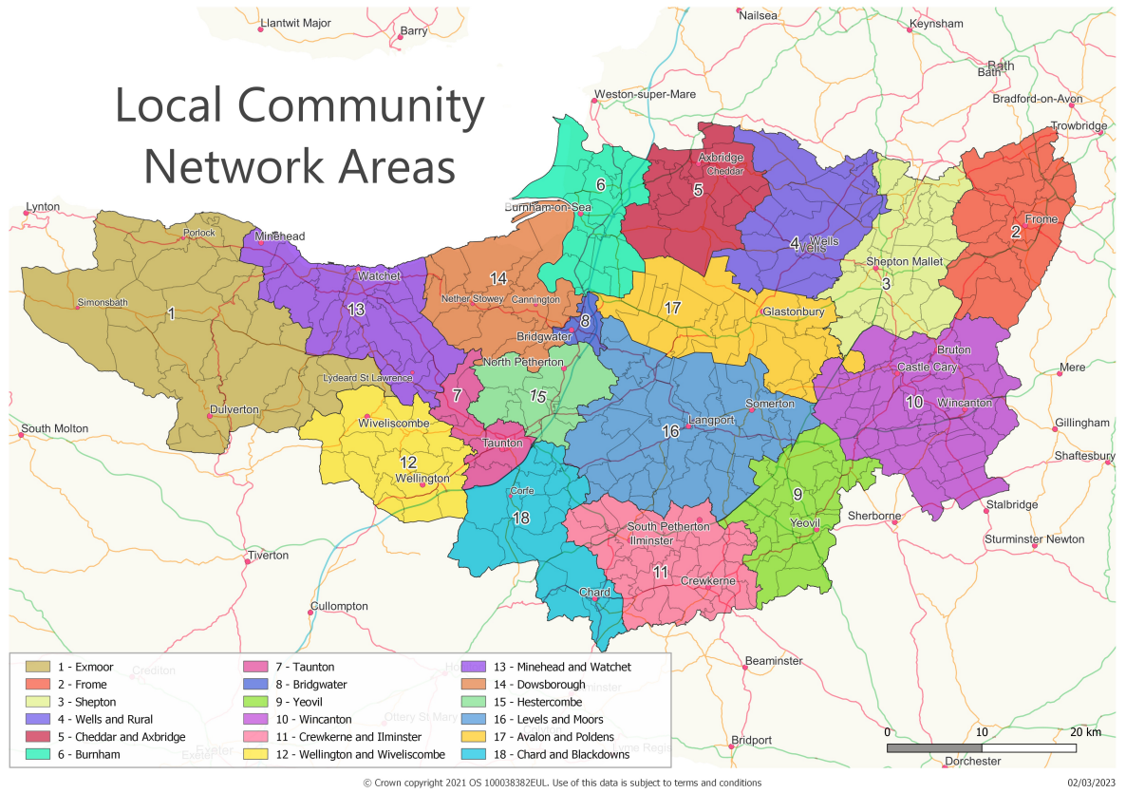
Local Community Networks (LCNs)
The focus for the new Council for community engagement and development.
Contact LCN@somerset.gov.uk to get involved!
www.somerset.gov.uk/local-community-networks/
Notes:
The Local Community Networks are starting up over 18 area cross Somerset. Their first meetings are running from June to August. Their purpose is to be the focus for the new Council for community engagement and development, within an ethos of local partnership working, looking to improve outcomes for residents through establishing strong connections between Somerset Council, our communities and our partners. This will include social, economic and environmental priorities set by the individual areas and based on data and evidence provided already, and supported by our partners & stakeholders expertise (e.g. environmental groups, etc)
Green partners are encouraged to contact LCN@somerset.gov.uk if they would like to join the LCNs to promote green/Climate & environmental community matters

Slide 23
Time for Questions
Contact: climateemergency@somerset.gov.uk

