Slide 1

Low carbon retrofit
Taking a whole house approach
Lorna Barraclough
Retrofit Assessor
Centre for Sustainable Energy
Nikki Brain
Resilience Manager
Frome Town Council
Credit: James Mullen, Retrofit Coordinator, CSE

Slide 2

The whole house, fabric first approach
Fabric measures:
  Airtightness and ventilation
  Roofs,
  Walls
  Floors
PV and heat pumps
Funding and contractors

Slide 3
Retrofit?
Addition to existing building to improve its energy performance and comfort level
UK has some of least energy efficient housing in Europe
High and rising levels of fuel poverty
Domestic heating contributes 14% to total UK carbon emissions

Slide 4
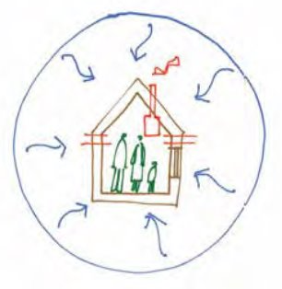
The whole house approach
Considers the building fabric, services, who lives in it
and the surrounding environment
Looks at maintenance and repairs first
Includes issues such as damp and ventilation
Sees the home as a system with interacting elements
Helps to decide the order in which to carry out improvements
Helps to identify potential problems which could result from retrofit

Slide 5
Understand your home
Traditional or modern?
What materials?
Moisture management?
How has it been changed?
Heritage?
All have implications for retrofit

Slide 6
'Fabric first’ approach
Prioritises external shell before building services to minimise space heating demand
Maintenance
Airtightness
Ventilation
Insulation – walls, roofs, floors, windows/doors
However, adding heat pump earlier could make sense
Reduces size of heating system

Slide 7
The retrofit process
Understand your building and energy use
Have a survey by a retrofit assessor/surveyor
Decide on your retrofit pathway
Repair and maintenance
Basic/soft measures (e.g. loft insulation, draughtproofing)
Deeper fabric measures
Low carbon heating and renewables (PV)
Monitoring, evaluation, review and improve

Slide 8

Maintenance
Repair/restore building before adding anything new – if at all!
Moisture responsible for vast majority of building problems
A damp wall is a cold wall! 30% more heat loss
Correctly identify and resolve damp
Fix leaks, roofs and gutters; high ground levels; vents

Slide 9
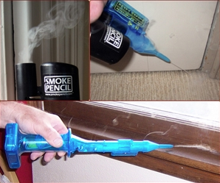
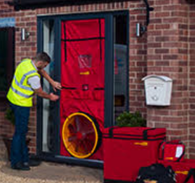
Draughtproofing
Eliminate air infiltration and leakage
  15% of typical home's heat loss
Can make lower temperatures
feel more comfortable
Often cheap and easy solutions
Smoke pencils, pressure tests and/or thermal imaging to locate draughts

Slide 10
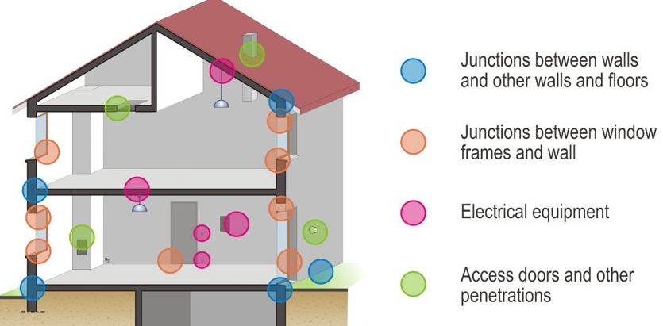
Mind the gap...

Slide 11
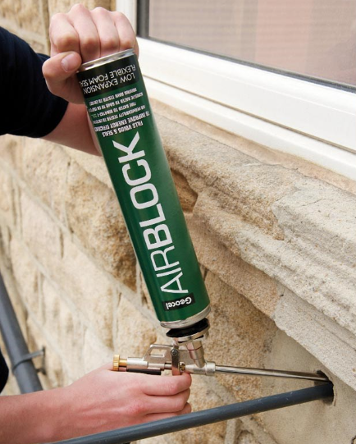
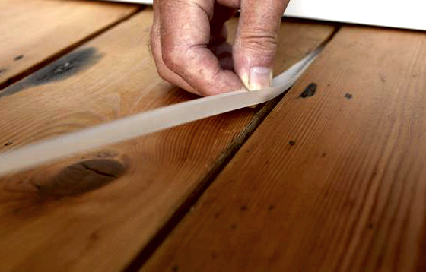
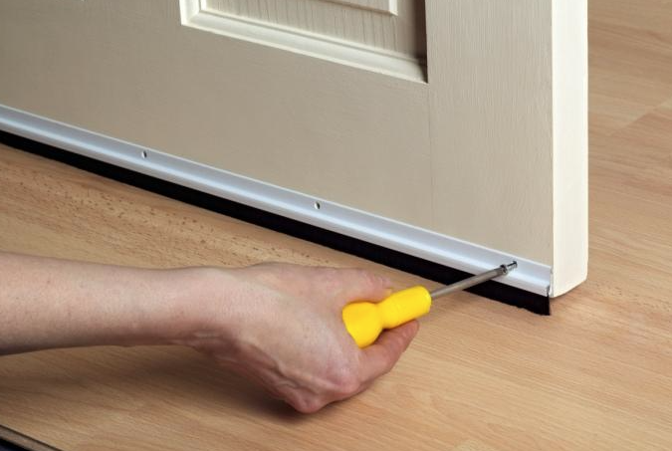
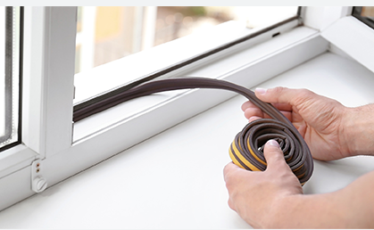

Slide 12
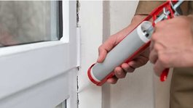
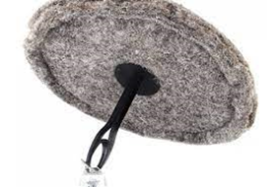
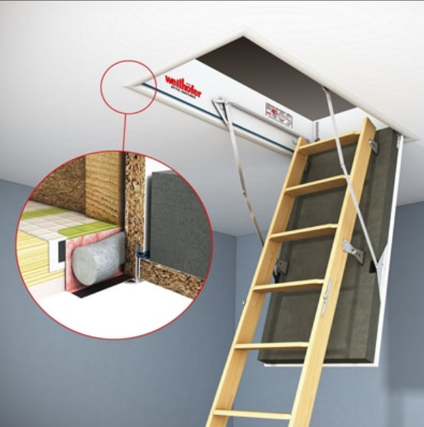
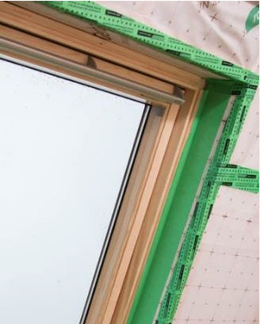

Slide 13
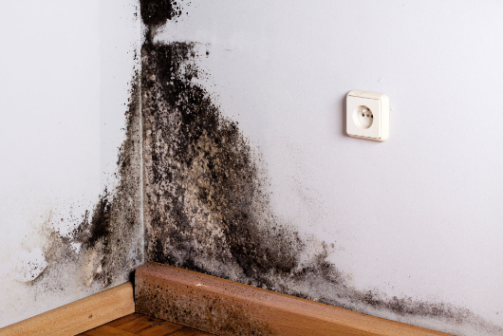
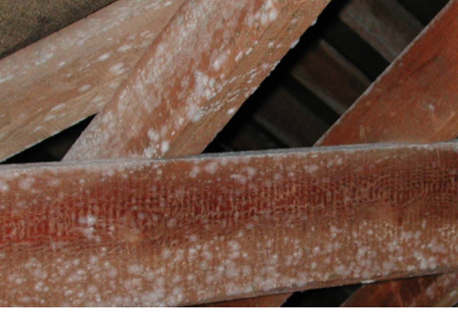
Ventilation
Eliminate unwanted ventilation but ensure intentional ventilation:
‘Build tight, ventilate right’
Extract of moist, stale air from wet rooms and supply of fresh air essential for human (and building) health

Slide 14

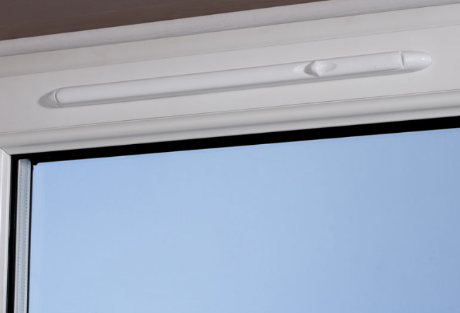
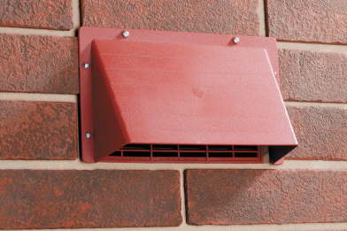
Ventilation types
Minimum: intermittent extract ventilation (IEV) in wet rooms with trickle vents on windows or wall vents
Continuous fans (mechanical extract ventilation/MEV) better and essential with higher airtightness: centralised or decentralised
Mechanical ventilation with heat recovery (MVHR)
  Minimises heat loss and filters air
  Requires very high levels of airtightness
  Requires regular cleaning/service
  High capital cost and large unit
MEV and MVHR harder to retrofit (unit and ducting)

Slide 15
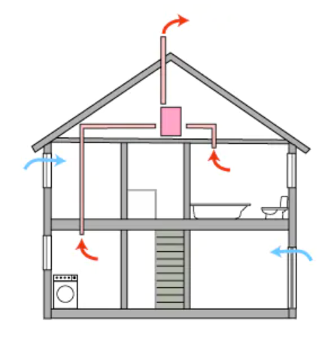
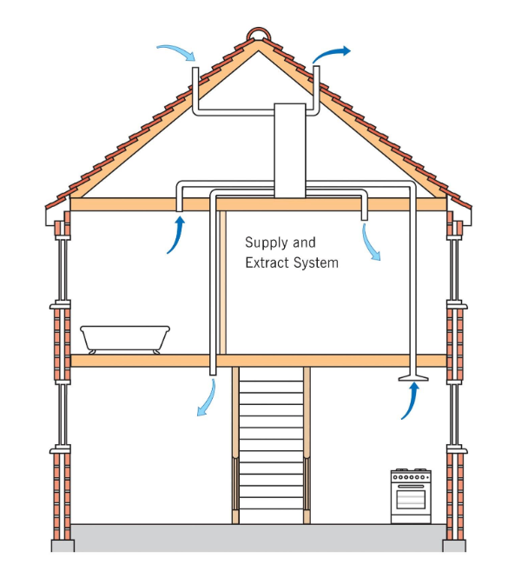
MEV
MVHR

Slide 16
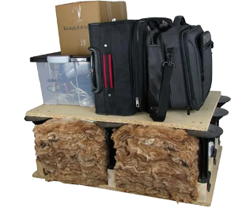
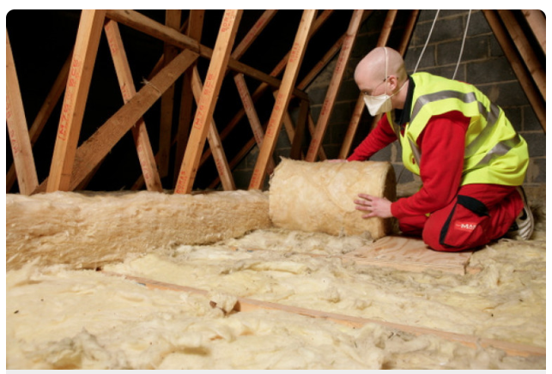
Insulation - lofts

Slide 17
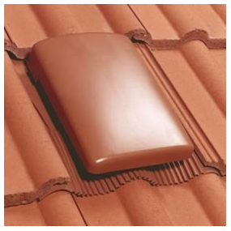
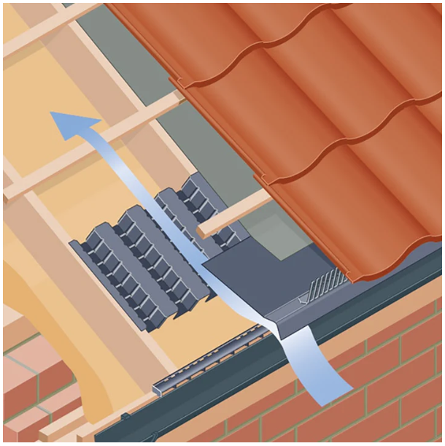
Ventilation is essential

Slide 18

Insulating at rafter level
Range of approaches and materials with implications for disruption, access, cost, moisture risk and ventilation:
  Between rafters:
    ceilings down, limited depth, moisture risk...
  Above rafters (and between):
    scaffolding, roof removal, raise ridgeline...
  Below rafters (and between):
    lose head room, moisture risk...

Slide 19
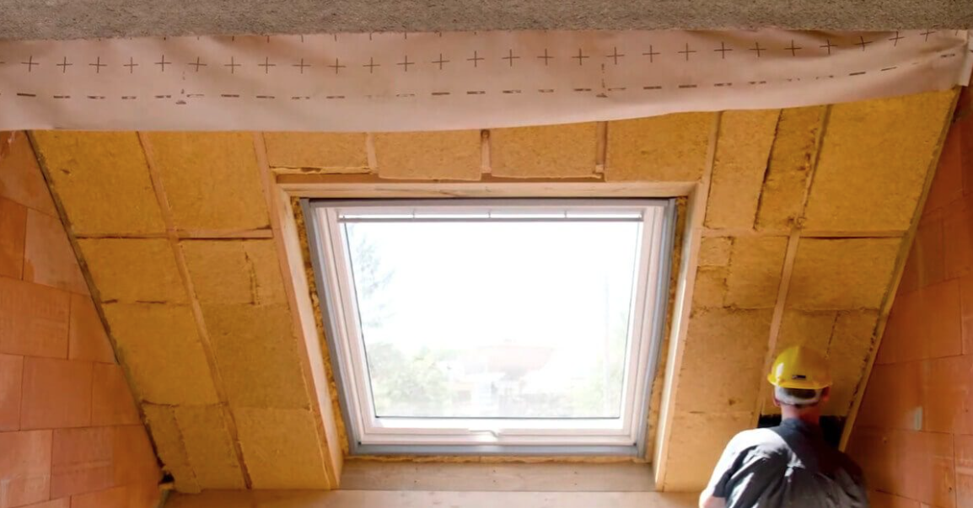

Slide 20
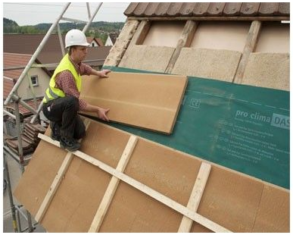

Slide 21
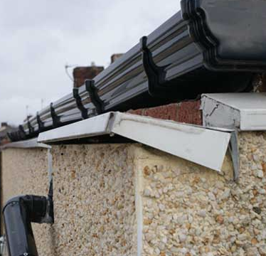
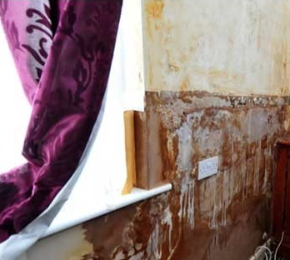
Solid wall insulation – external or internal
Both are expensive and high risk (£150/m²)
History of poor practice with dire consequences
Needs to work with original construction
Risk of thermal bridging and moisture ingress
Robust detailing is critical!

Slide 22
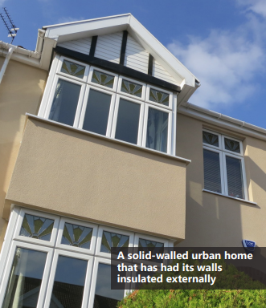
Externally insulating your home costs on average £12,000,
A typical 3-bedroom semi-detached house using gas heating could save around £558 per year on heating bills by installing external wall insulation
A detached house could save around £708 per year
(figures from the National Housing Model).

Slide 23
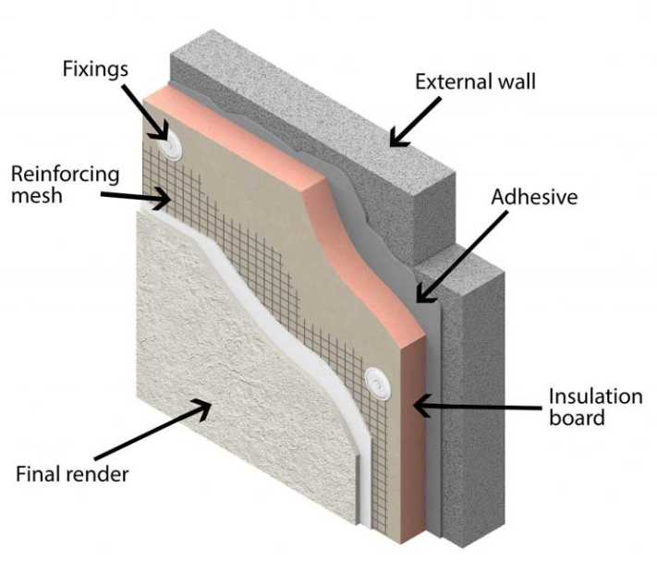
External wall insulation

Slide 24
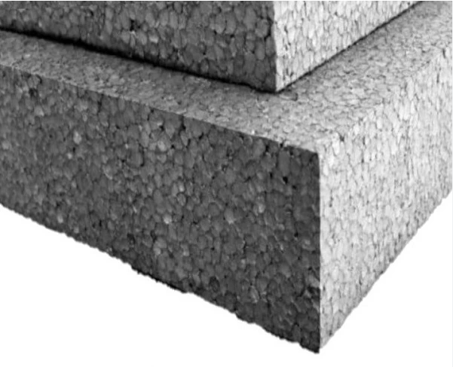
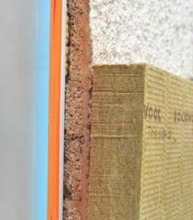
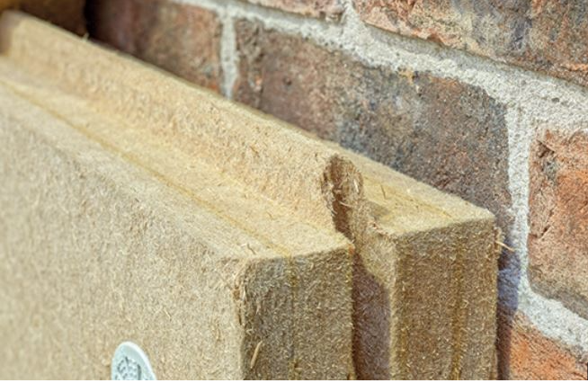
EWI materials

Slide 25
Disadvantages:
Changes external appearance!
May need planning permission
Need to move rainwater goods, aerials, alarms etc
May need to extend roof
Windows?
Good detailing essential!
Advantages:
‘Wraps’ your home so continuous insulation and less thermal bridging
No internal work:
  No loss of space
  No moving radiators, sockets, skirting etc
  No redecoration
Keeps thermal mass inside
Improves external appearance?

Slide 26
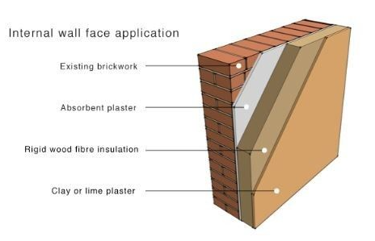
Internal wall insulation

Slide 27
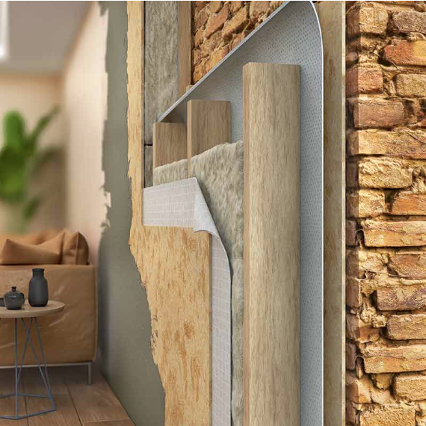
Internal wall insulation

Slide 28
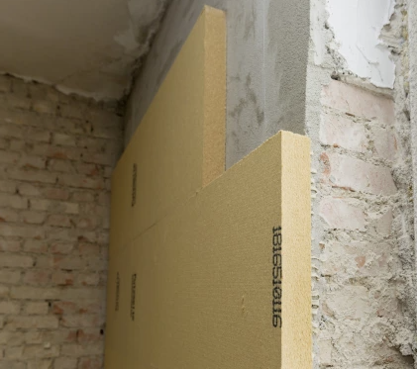
Internal wall insulation

Slide 29
Internal wall insulation
Disadvantages:
Lose space
Need to move radiators, sockets, switches, skirting etc
Need to redecorate
Lose thermal mass BUT heats up quicker
Significant risks around moisture – especially with synthetic materials
Advantages:
No change to the outside
Room-by-room
Probably cheaper than EWI

Slide 30
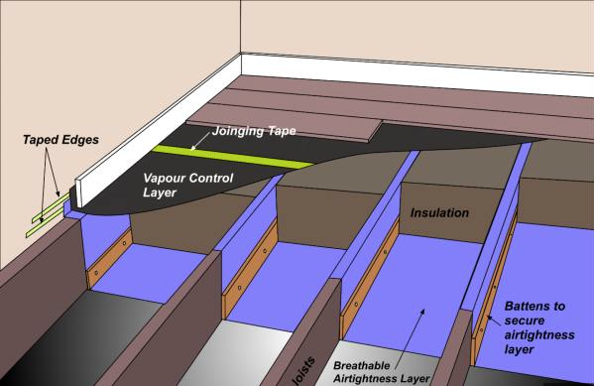
Suspended floor insulation

Slide 31
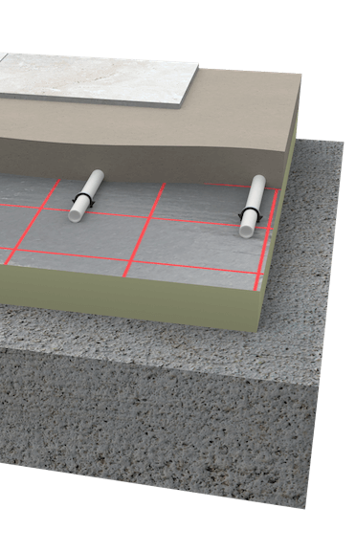
Solid floor insulation
Typical construction uses vapour closed insulation and vapour barriers
Replacing suspended timber floors can force moisture into the walls – inc party walls
Alternatives exist using 'capillary break' insulation and vapour permeable limecrete

Slide 32
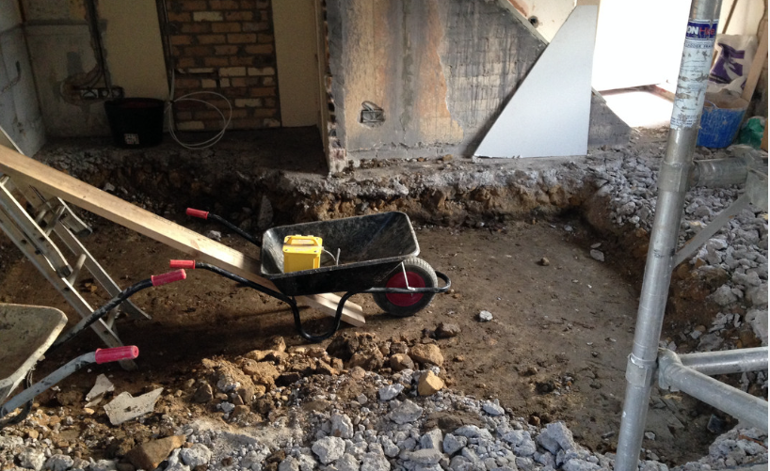
Solid floor insulation – a big job!

Slide 33
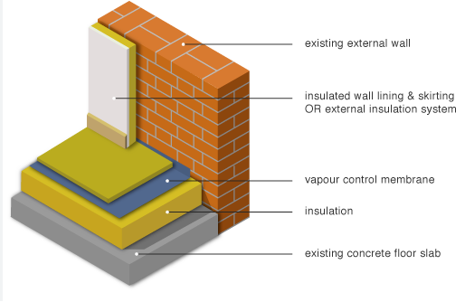
Insulation over existing slab
However, this will raise your floor height – kitchen, stairs, doorways etc...

Slide 34
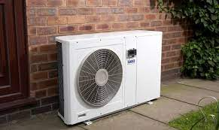
Heat pumps – what are they?
Absorbs ambient (and renewable) heat and increases its temperature using refrigerant cycle and electricity
Air, ground or water source
We all have one already (but in reverse) – in our fridge
Heat supplied via air or water (central heating)
Low and potentially zero carbon
£8 – £12,000 install cost (£5k grant)

Slide 35
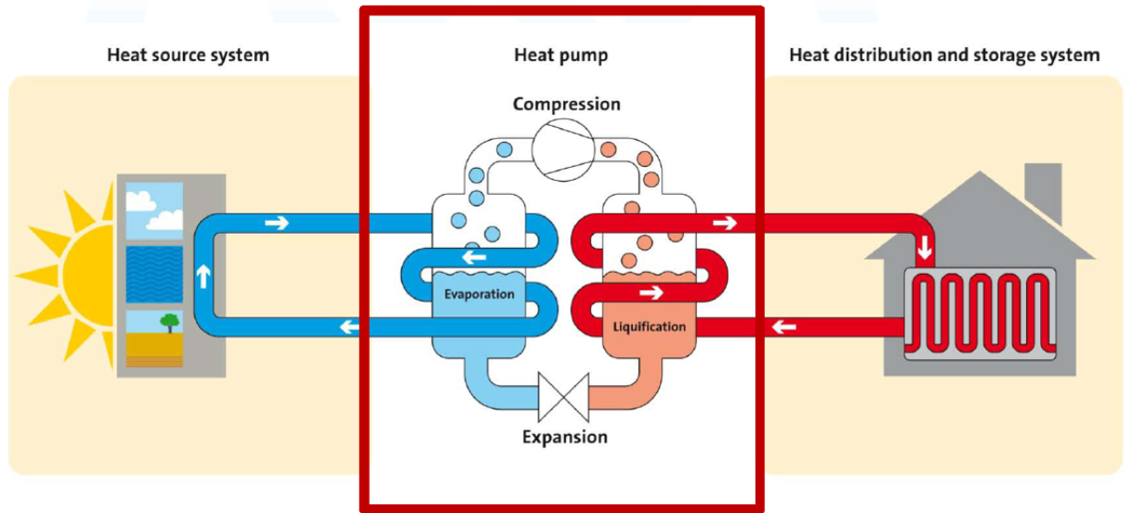

Slide 36
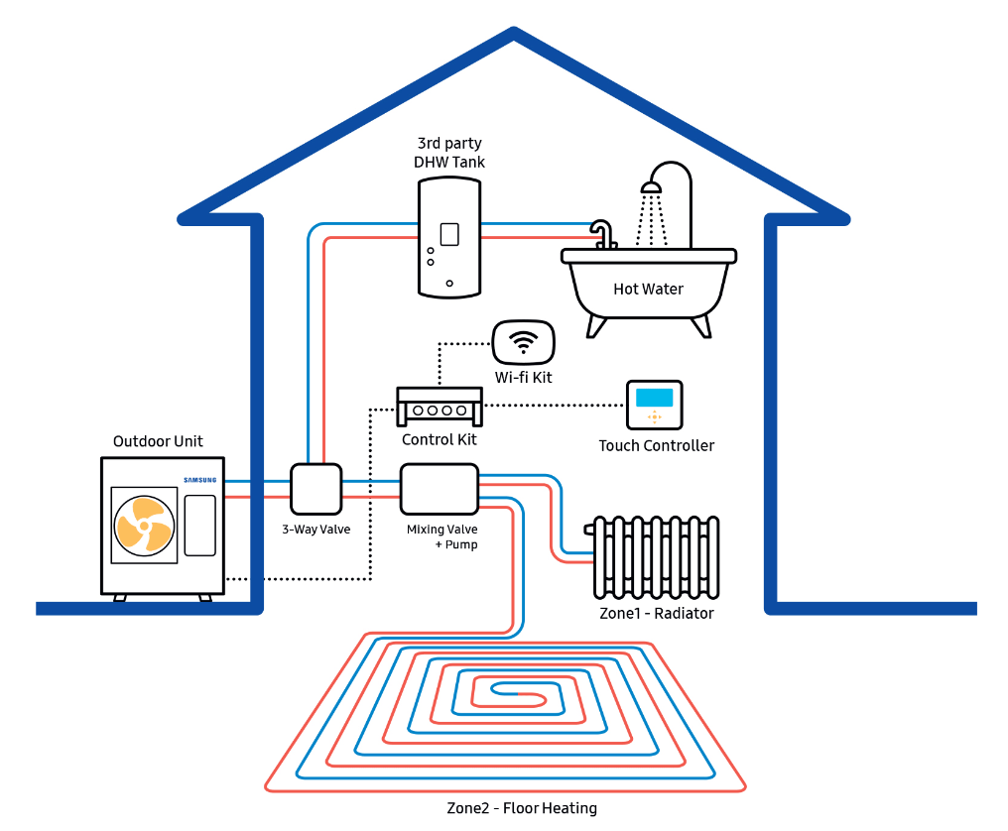

Slide 37
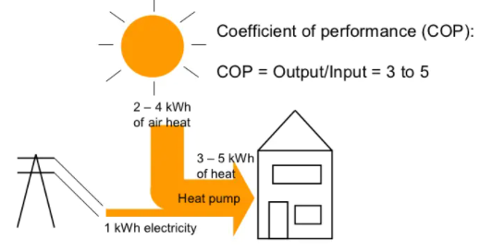
It’s all about their efficiency…

Slide 38
COP = efficiency at a particular time
COP reflects how hard the heat pump has to work
Determined by temperature difference between
source and supply
Varies throughout the year
Annual average is key – Seasonal COP (SCOP) or
Seasonal Performance Factor (SPF)
SCOP of 3 should be minimum target for ASHP

Slide 39
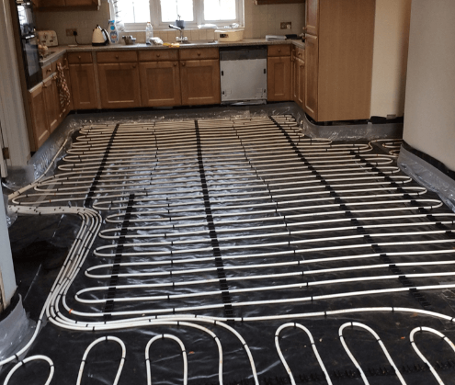
Minimising flow temperatures
Aiming for max 50°C (70°C typical in boilers)
Reduce heat demand: ‘fabric first’
  insulation and airtightness
Increase emitter size (supply)
  UFH and bigger radiators
Constant heat rather than cycling
(operation)

Slide 40
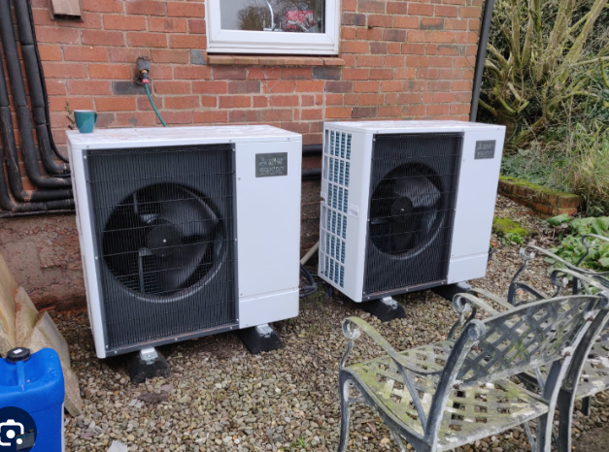
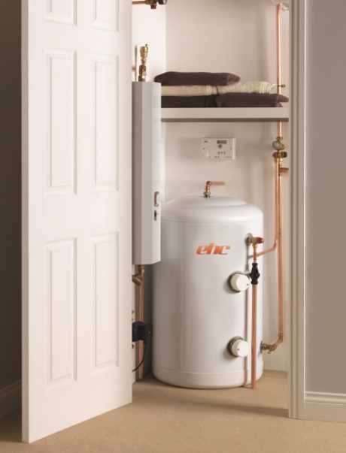
Constraints
Outdoor space
Electricity connection
Indoor space (HWC)
Pipework
Radiator sizing and position
Fabric efficiency

Slide 41
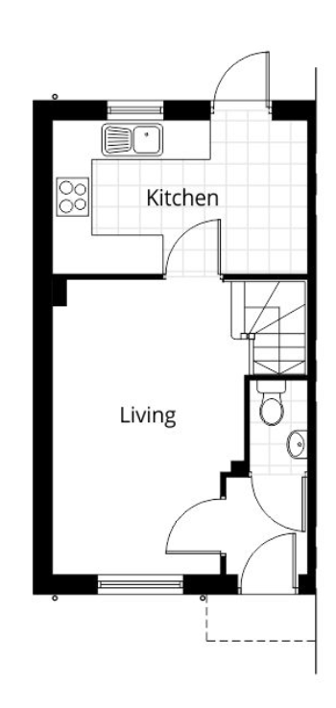
Installation process:
Initial remote feasibility – EPC
Detailed survey – room by room heat loss calculations
Room specific heat loss (W/m²) and flow temperature inform sizing of emitters
Total heat loss used to size the heat pump

Slide 42
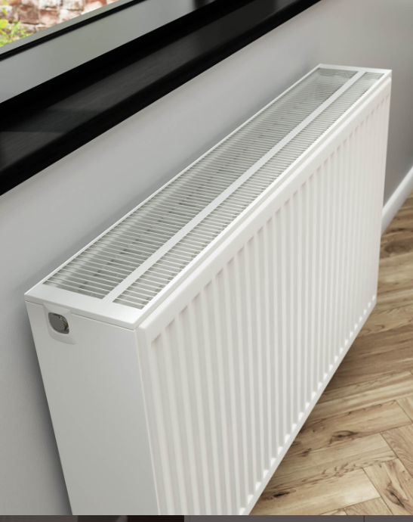
Heat pumps can heat any building in theory, but…
  size of radiators and heat pump needed often impractical and cost prohibitive
  mid-terrace with loft insulation and double glazing but no wall insulation should be viable
  harder with more uninsulated (solid) walls
Sizing of radiators for low flow temp most critical

Slide 43
Will they reduce emissions and bills?
 | ASHP | Old gas boiler | New gas boiler
Efficiency (COP) | 300% (SCOP – 3) | 70% | 90%
Fuel consumption (kWh) (20,000kWh heat demand) | 6,667 | 28,571 | 22,222
Carbon factor of fuel (kgCO₂e/kWh) | 0.233 (grid electricity) | 0.21 | 0.21
Annual emissions (kgCO₂e) | 1,553* (could be 0) | 6,000 | 4,667
Annual fuel cost (£/year) | 2,267 (34p/kWh) | 2,857 (10p/kWh) | 2,222 (10p/kWh)

Slide 44
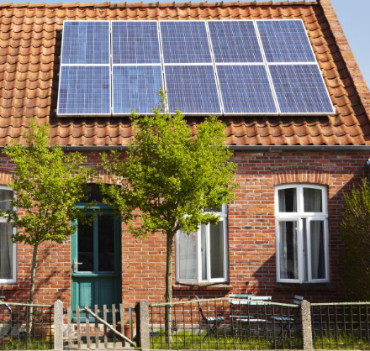
Solar photovoltaics (PV)
Cost drop 50% in 10 years
Subsidy/payments reduced
Typical 4kWp system
  £6-8,000
  3,500kWh/year
  25m²

Slide 45
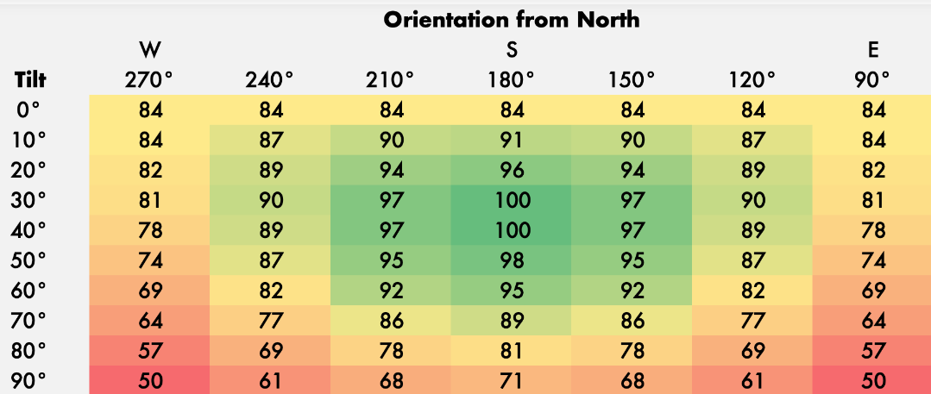

Considerations
Orientation
Planning constraints
Roof structure
Occupancy and usage
SEG tariff

Slide 46

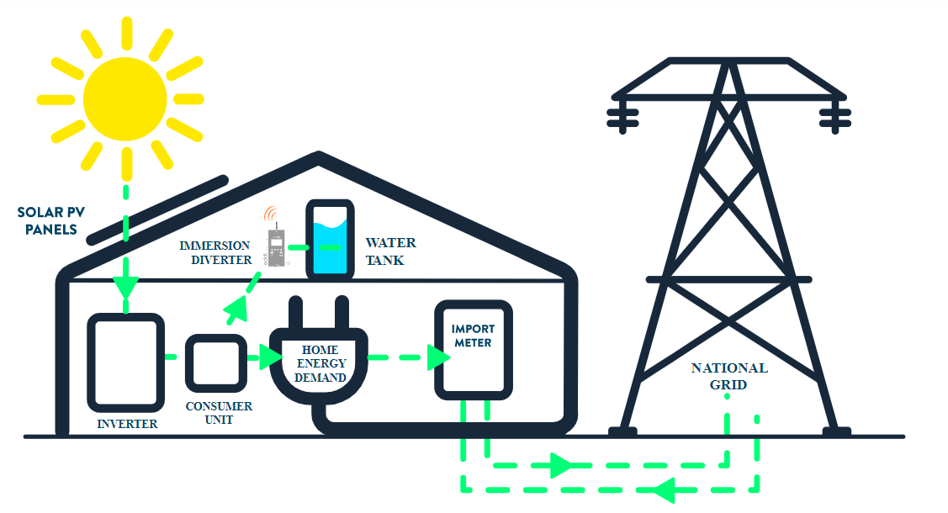
Maximising PV benefit
Use more electricity when the sun shines!
  Makes less sense if out all day
PV-diverter if you have hot water cylinder
Batteries may make sense for some people but high costs and ecological impact
Heat pump or EV better eco investment!

Slide 47
Funding (non means tested)
Boiler Upgrade Scheme, started 1st April 2022 (replaces Renewable Heat Incentive):
  Grants of £5,000 for ASHP or biomass boiler, £6,000 for GSHP
Smart export guarantee (solar PV) – payments from electricity supplier for exporting electricity generated on site (4 – 15p/kWh)
Great British Insulation Scheme (ECO+) – full or partial grants for anyone with EPC D or lower + Council Tax band A-D focused on low cost single measures. Keep an eye out this summer!
Lendology - CIC providing low interest loans in the South-West using Council funds.

Slide 48
Funding (means tested)
      Eligibility is complicated – call us for more advice! Generally speaking, to get a grant, you must be on means tested benefits, and/or have household income below £30K, with savings limits.
Home Upgrade Grant scheme (HUGS) – central government funding:
  Off-gas properties
Energy Company Obligation (ECO) – funding from large energy suppliers/ ECO Flex
Social Housing Decarbonisation Fund – central government funding:
Local Authority or social housing provider led schemes
Safe, Warm and Secure grants- Somerset Council

Slide 49
Finding contractors
RETROFIT! Somerset https://retrofitsomerset.info/
Trustmark – government endorsed quality scheme
https://www.trustmark.org.uk/homeowners
Microgeneration Certification Scheme – quality assurance scheme for renewables
https://mcscertified.com/find-an-installer/
Green Register – find sustainable construction professionals in the region
https://www.greenregister.org.uk/search
Checkatrade (and others) – public review based online listings
https://www.checkatrade.com/
Notes:
Lots of people find it difficult to find contractors to do their retrofit work, and find it even harder to find those that they can trust.
However, The National Insulation Association and the Microgeneration Certification Scheme both have sites where you can search for installers in your area.
These organisations don’t just provide a way to find installers, but they are schemes which certify their members so that they can guarantee a high level of quality.
The national insulation association specialises in, you guessed it, insulation. And the microgeneration certification scheme certifies installers of solar photovoltaics, wind power, heat pumps, battery storage and more low-carbon technologies.

Slide 50


Healthy Homes
Free Independent retrofit assessments from Frome Town Council
Local energy advice drop- ins supported by CSE
Home visits and funded small measures
EnergyAdvice@frometowncouncil.gov.uk

Slide 51
Thank you!
Any questions?
www.cse.org.uk
www.futureproof.org.uk
Energyadvice@frometowncouncil.gov.uk

